Slide 1

Athletic Administration: Leadership or Management?
James Perry, EbPA
CIFSS Administrator’s Summit
October 6, 2025
Riverside, CA.

Slide 2
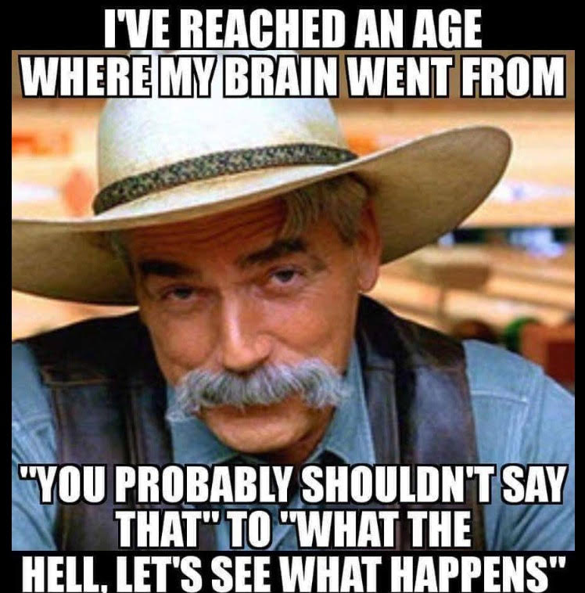
What Is My Role Today?

Slide 3
California Interscholastic Federation
10 Sections make up the State CIF.
1632 member schools: public and private (389).
564 member schools in the Southern Section.
197 of the membership are private schools.
900,000 plus student athletes statewide.
44% of our student's participation rate statewide.

Slide 4
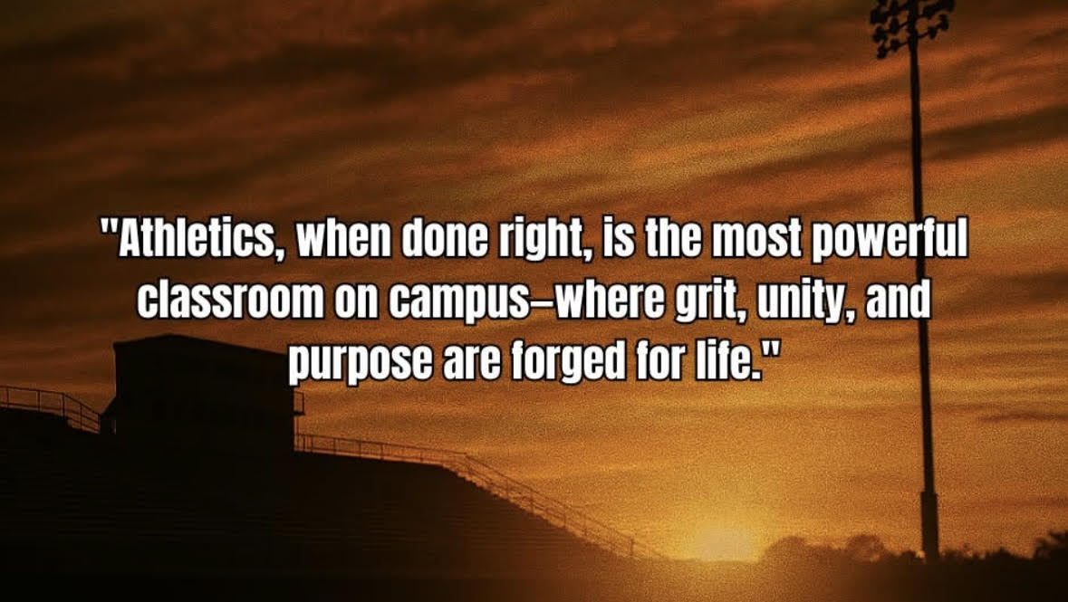
Welcome to Our Classroom

Slide 5
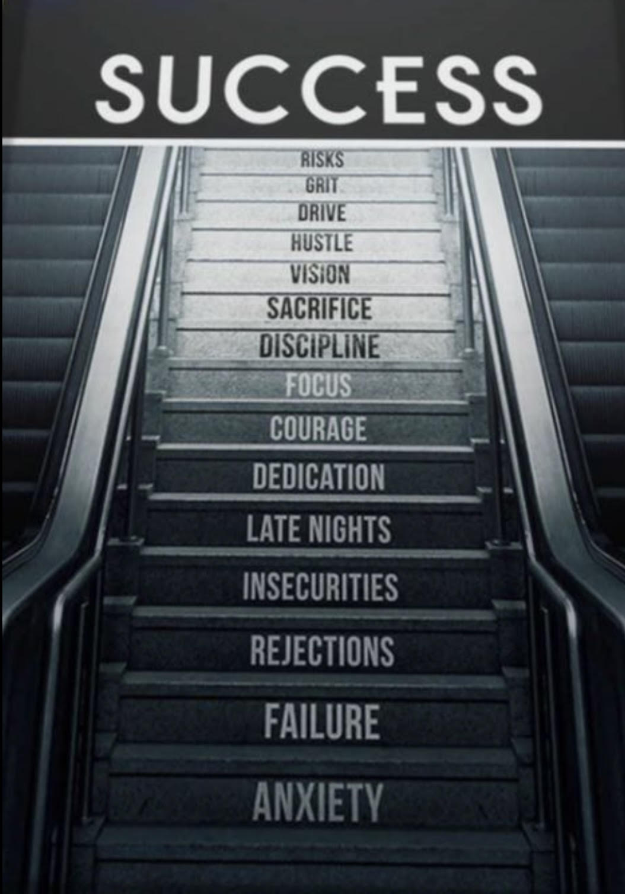
Education Based Athletics Lesson Plan

Slide 6
Kids Today
“The children now love luxury; they have bad manners and contempt of authority; they show disrespect for their elders and love chatter in place of exercise. Children are now tyrants, not the servants of their households. They no longer rise when elders enter the room. They contradict their parents, chatter before company, gobble their food at the table and terrorize their teachers.”
-- Socrates 399 B.C.

Slide 7
What Is Our Role?
Is it Leadership?
“One who guides and/or directs a group providing vision, initiative, stewardship and guardianship.”
Is it Management?
“The act or manner of managing and providing administrative skills.”
CIFSS Blue Book: Duties of the Principal: pages 46 - 47

Slide 8
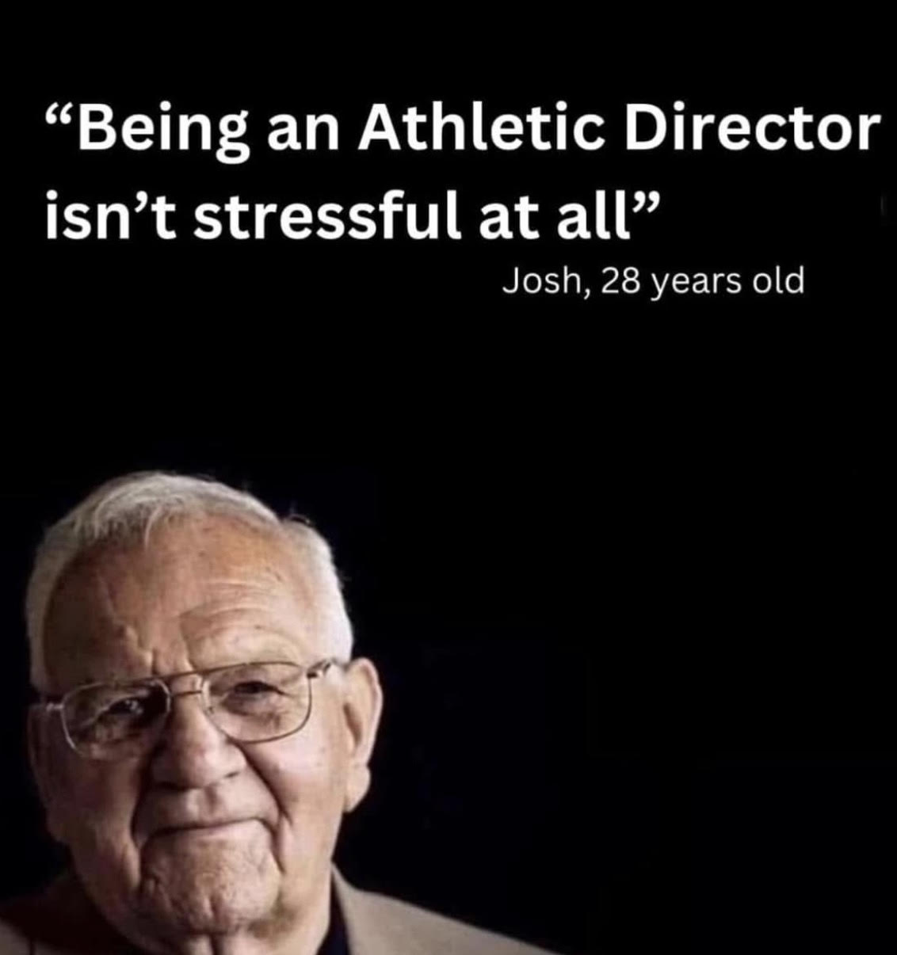

Slide 9

Buckle Up Buttercup

Slide 10

11/11/11 . . . 5/26/17 . . . 9/17/19

Slide 11
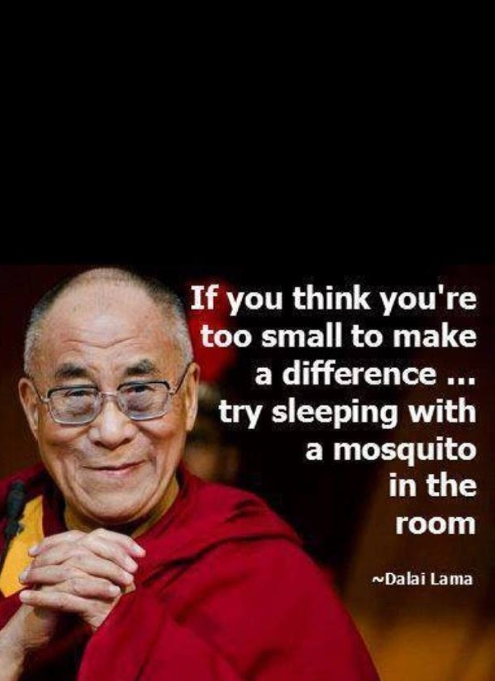
How Important is Our Position?

Slide 12
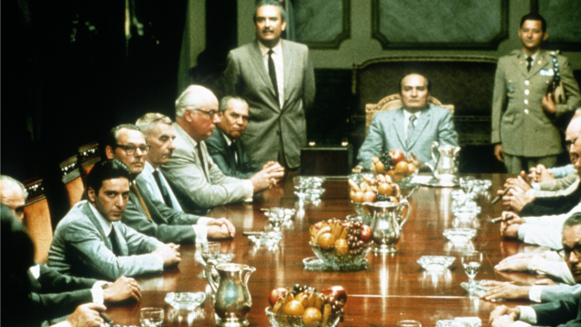
Advisory Council on Call . . . “I got 'a guy”

Slide 13
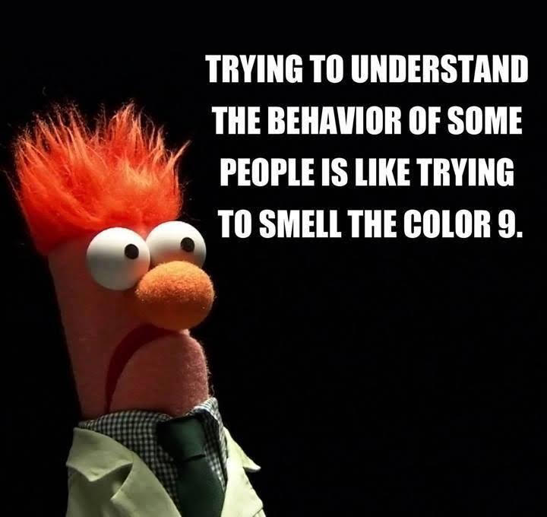
The Length of a Conversation Has Nothing to do With Intelligence

Slide 14
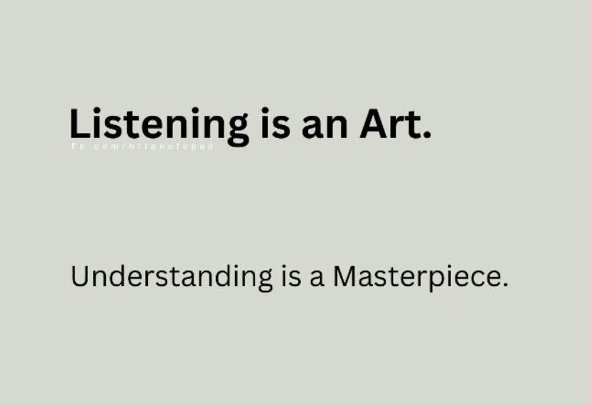
Be Quick to Listen & Slow to Speak

Slide 15
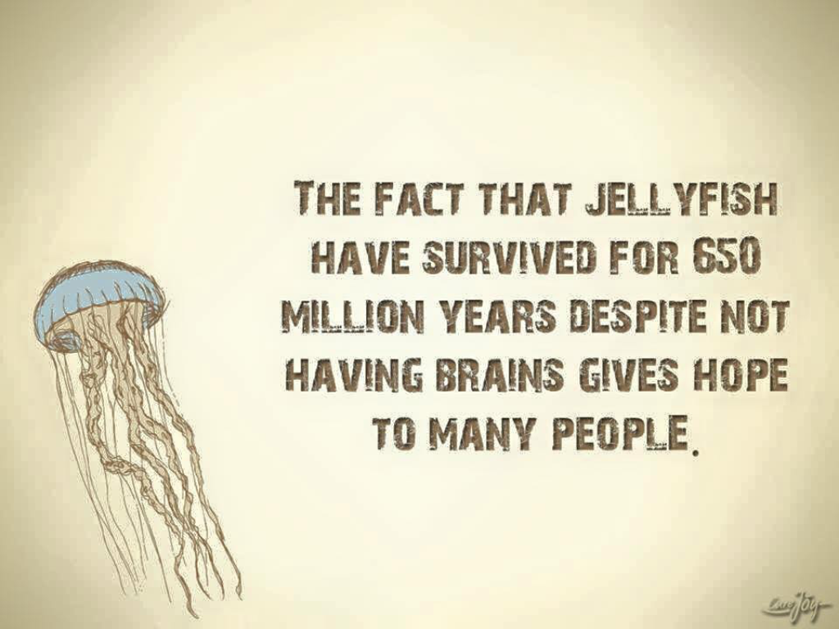
We All Know Them . . . Deal With It

Slide 16
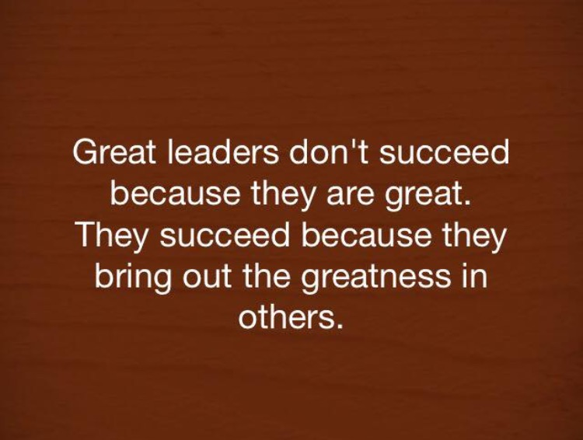
Empower Our People

Slide 17
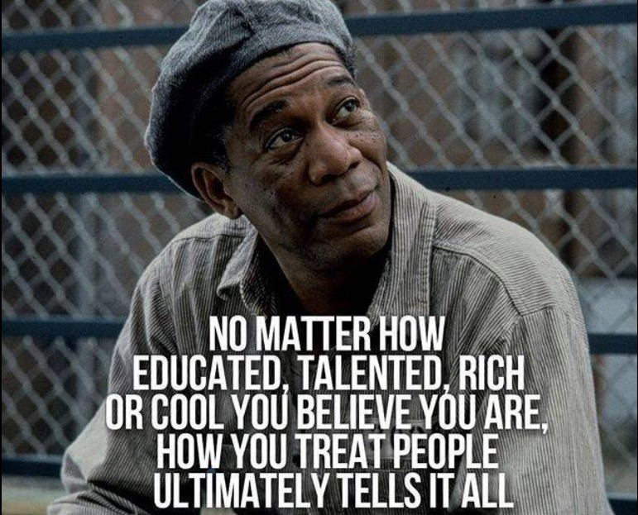
If You Are The Smartest Person In The Room . . . Find Another Room

Slide 18
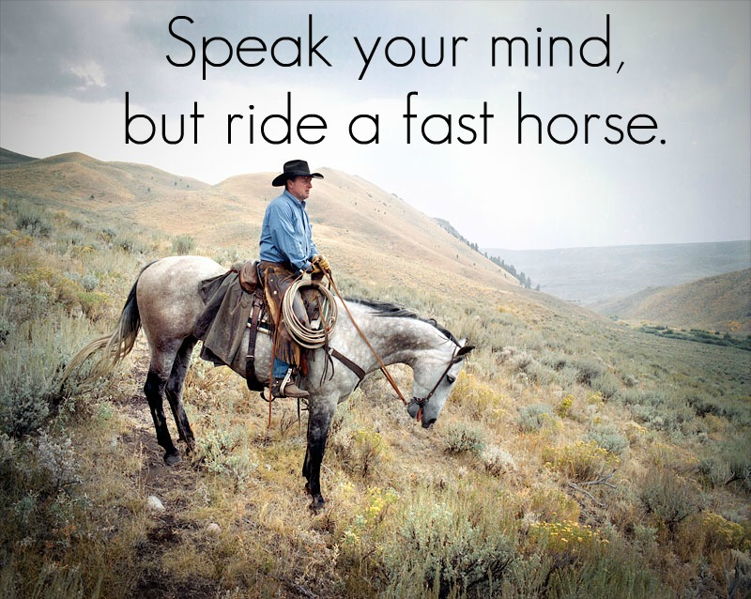
If Your Horse Is Dead . . . Dismount

Slide 19
What we permit, we promote.
What we condone, we own.
What we tolerate, we deserve.
-- Anonymous

Slide 20
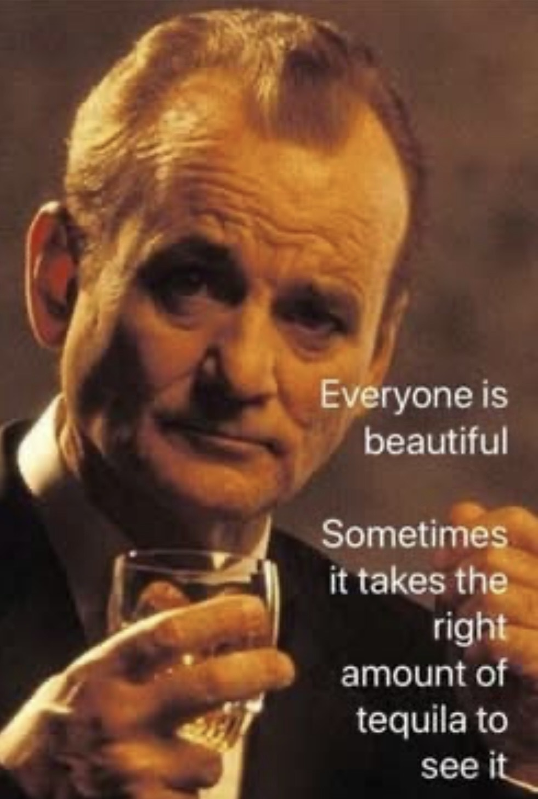
Find a Way to Say “Yes” . . . Gray is a Color Too

Slide 21

Never Miss an Opportunity to Shut Up

Slide 22

Take Care of Our People

Slide 23
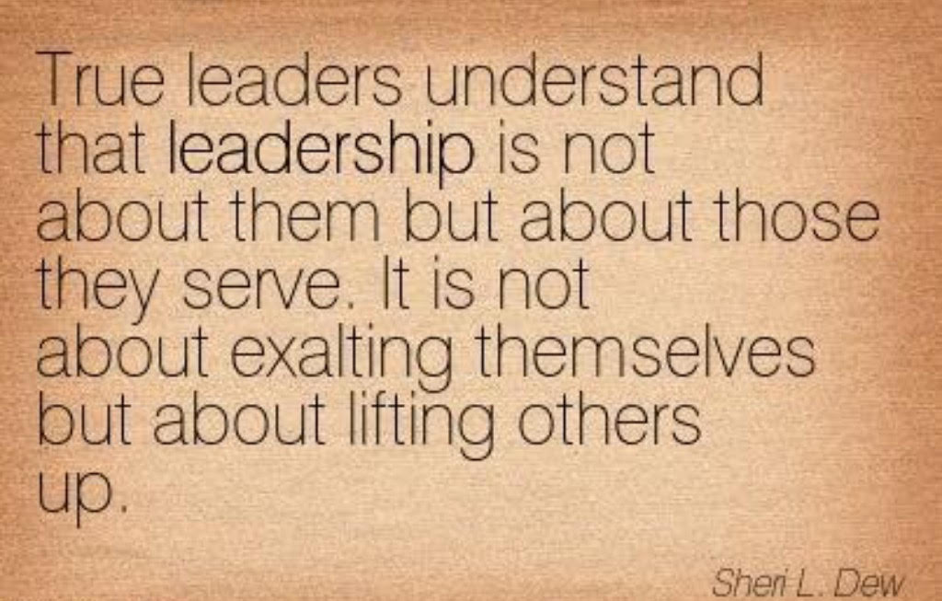
Servant Leadership

Slide 24

Be a Plant Whisperer

Slide 25

Be The Model

Slide 26
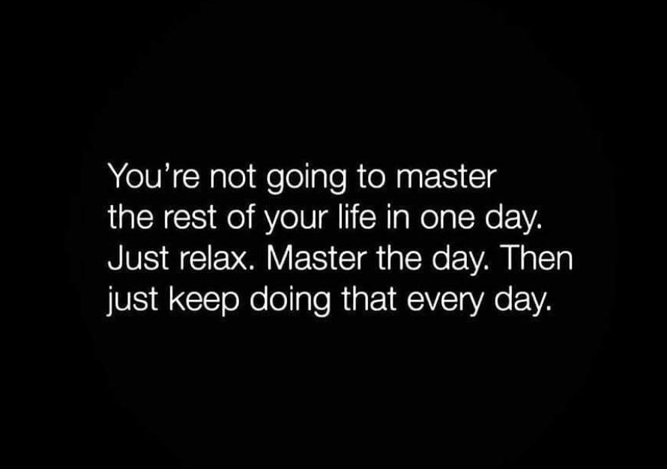
Go Slow . . . As Fast As We Can

Slide 27
What Is Our Body Count?
Is it our administrative/coaching tree?
Is it how many people we have sent out into new administrative/coaching positions?
Or is it how many people we have lost?
That is our number.
That is our body count.

Slide 28
Old School Leadership Lessons
“Never tell people how good you are. If you’re good, people will tell you how good you are.” -- Dr. Richard Perry, PhD
“Just do simple better . . . Trust me, I'm a Doctor.”
-- Dr. J. Tillman Hall, PhD
I, My and Me . . . Vs . . . Us, Our and We
-- James Perry, EbPA

Slide 29
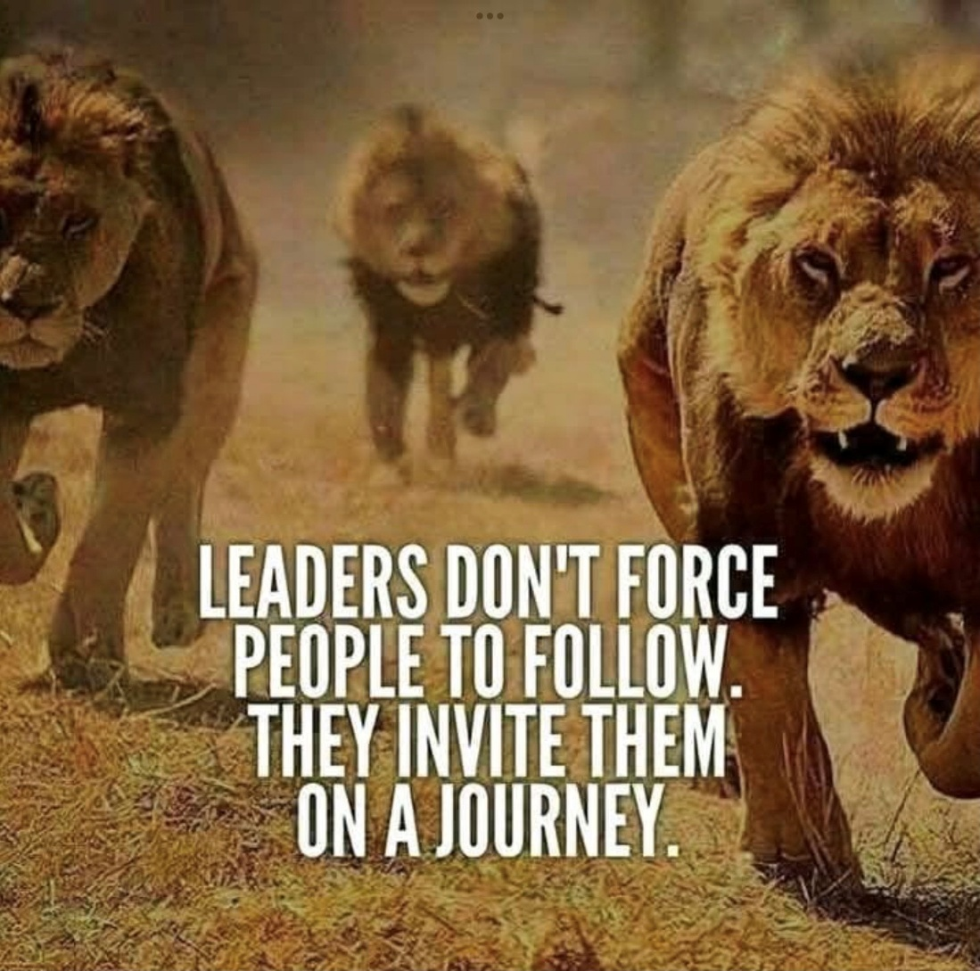

Slide 30
Learn to Supervise Guided Failure
  There are going to be some tough lessons.
  Cherish every level of success.

Slide 31
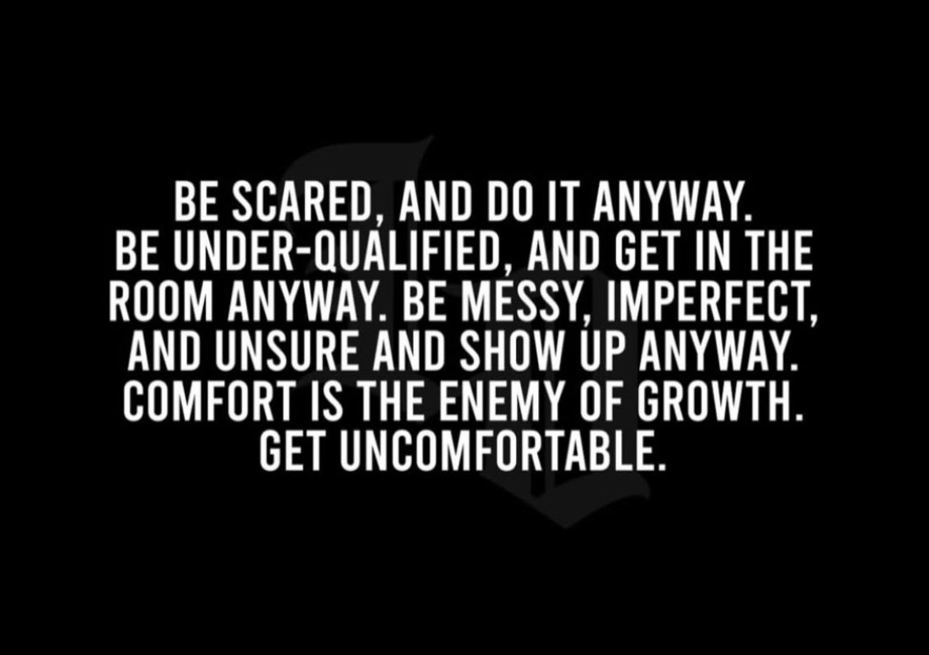
Learn to be Uncomfortable

Slide 32
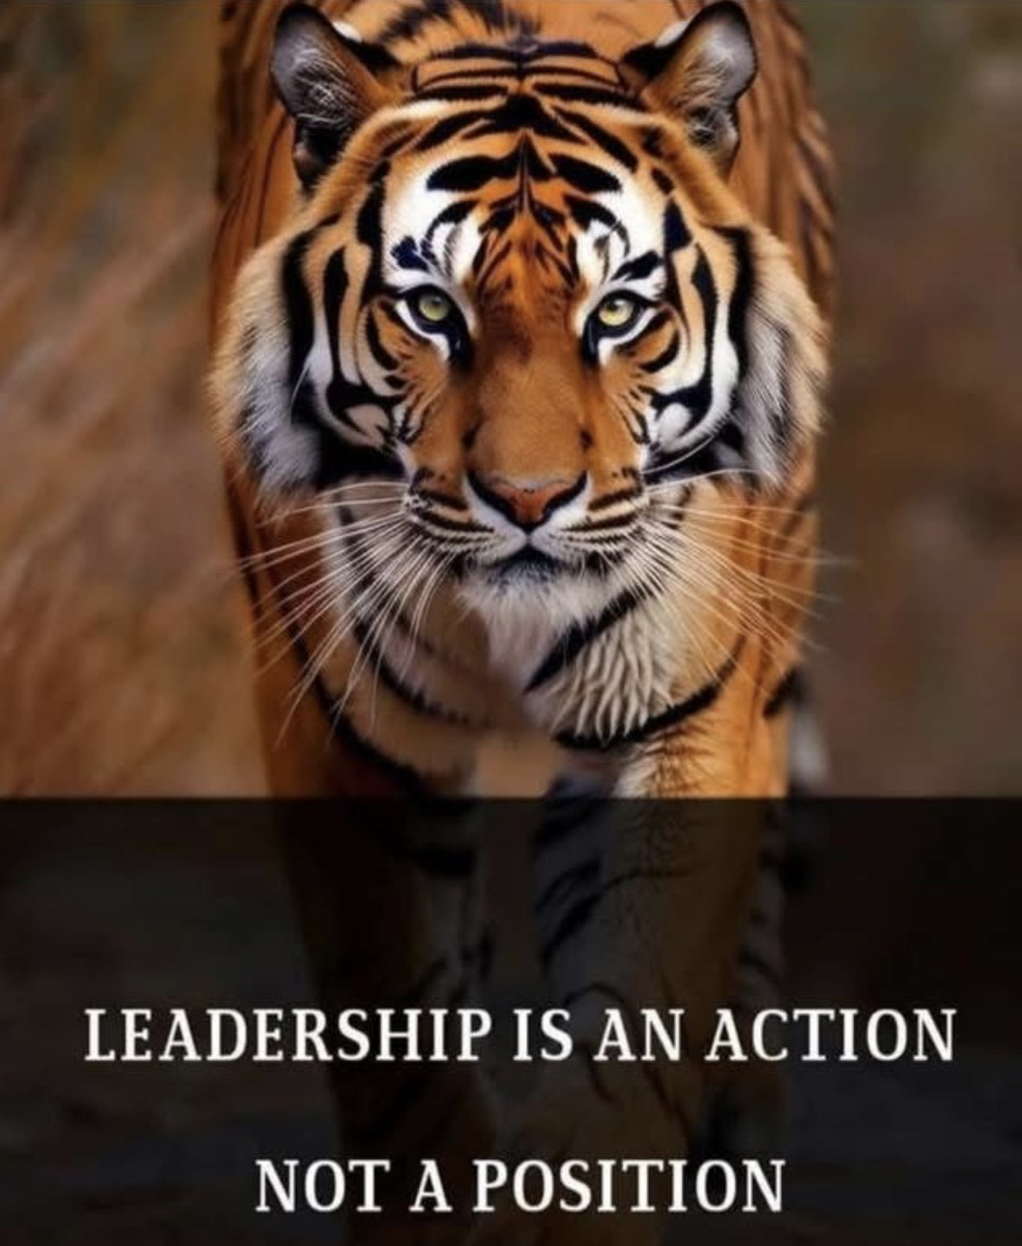

Slide 33

Organizational Non-Negotiables
“Ride for the brand”
-- Grandpa Doc
“The logo never comes off”
-- USC Athletics

Slide 34

Absolute Fact of Life

Slide 35
Athletic Administration:
Is Our Role
Leadership or Management?
Yes.
Yes, it is.

Slide 36

Here is Your Chance
Questions
Comments
Corrections
Suggestions

Slide 37
Thank You & Good Luck
James Perry, EbPA
District Athletic Director
Huntington Beach Union High School District
5832 Bolsa Avenue
Huntington Beach, CA. 92639 USA
Email: JPerry@hbuhsd.edu
X / Twitter: PerryJamesLusc
Phone: 714-904-7689

