Slide 1
G - Force
Leadership Academy

Slide 2
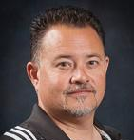
Hello!
Matt Maeda
Athletic Director
San Gorgonio High School

Slide 3
The Evolution of G-Force
From...
PEP
Leadership

Slide 4
Purpose
To Teach Skills
Character
Leadership
Team Building

Slide 5
Purpose
Who?
Captains
Senior Leaders
Future Leaders

Slide 6
For the benefits of:
Students
Coaches
Teams
School

Slide 7
When?
Late Start Mondays
Lunch
1 - 2 times a month
Prep for Events

Slide 8
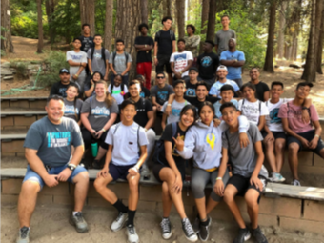
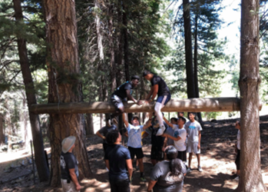
G - Force
Events
Ropes Course
UCLA IGTC
Hall of Fame
CSUSB/CBU/UCLA
Special Olympics
Rooter Buses
Professional Games

Slide 9
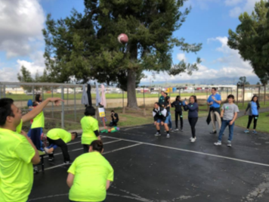
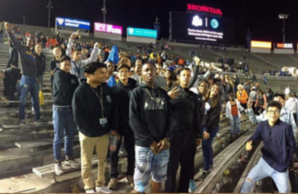
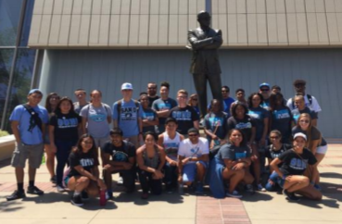

Slide 10
“ Things turn out best for the people who make the best of the way things turn out.”
-John Wooden

Slide 11
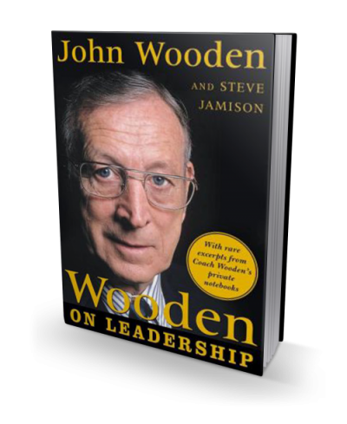
What?

Slide 13
6 Pillars of character

Slide 15
Articles / Literature / video
“Leader of the Pack” by Jeff Janssen
“More Important Than Talent” by John O’Sullivan
“We Need to Expect More From Our Kids, Ourselves” by Ruben Navarrete
“Big Goals Can Backfire! Olympian Swimmers Show Us What To Focus On Instead!” by Brad Stulberg

Slide 16
Articles / Literature / video
Golden Circle - Simon Sinek
Invictus movie clip: poem by William Ernest Henley
John Wooden on TED Talk
Sports Illustrated: “Sportsman of the Year”
“Words of Wisdom” from Spartan Alumni

Slide 17
questions?

Slide 18
thanks!
Any questions?
You can reach me at…
matthew.maeda@sbcusd.k12.ca.us

