Slide 1
Emergency Action Plan: Be Prepared
Matt Quijano MA, ATC
Athletic Trainer Arroyo Grande HS
CATA Region 4 Director

Slide 2
Housekeeping
CEU survey
Please mute your phones
DISCLOSURES:
No Disclosures

Slide 3
Plan for this Course
Why make an Emergency Action Plan (EAP)?
What should be included in your EAP?
Now that you have an EAP, what do you do next?

Slide 4
What is the purpose of an Emergency Action Plan?
Facilitate and organize employer and employee actions during a workplace emergency

Slide 5
Why Have an EAP?
6 Domains of Athletic Training
Consistency of care
Improvement of care over time
Legal Considerations
California Ed Code 35179.4 - “if a school district or charter school elects to offer any interscholastic athletic program, the governing board of the school district or charter school shall ensure that there is a written emergency action plan in place that describes the location and procedures to be followed in the event of sudden cardiac arrest and other medical emergencies.”
Notes:
Prevention, Clinical Evaluation and Diagnosis, Immediate Care, Treatment, Rehabilitation and Reconditioning, Organization and Administration, Professional Responsibility
Ed Code = written and posted under NFHS guidelines

Slide 6
I Will Never Actually Use This Plan

Slide 7
13.8 million Emergency Department visits per year
47% of commotio cordis injuries occur in athletics
1.6 to 3.8 million sports related mTBI per year
4126 Emergency Department visits annually. 3.5% are fatal

Slide 8
1 in 6 adolescents (12-17) experienced a major depressive episode
1 in 3 young adults (18-25) experienced a mental illness

Slide 9
CIF By-Law
These changes are proposed at this time.
503 - Administrative Oversight
L. Emergency Action Plans and AED Protocol
1A. Venue specific, annual practice with pertinent school staff and EMS providers
1B. Distributed to athletic department members and healthcare professionals who will provide care at games, practices, or other events

Slide 10
CIF By-Law
503 - Administrative Oversight
L. Emergency Action Plans and AED Protocol
2. Should include:
a. list all on-site emergency equipment that may be needed in an emergency situation
b. identify personnel and their responsibilities to carry out the plan of action
c. include appropriate contact information for EMS
d. specify documentation actions that need to be taken post emergency

Slide 11
CIF By-Law
503 - Administrative Oversight
L. Emergency Action Plans and AED Protocol
3. The school shall have at least one automated external defibrillator (AED) for the purpose of rendering emergency care or treatment. Ideally an AED should be located within 90 seconds of each athletic venue. The school shall ensure that the AED(s) are available to certified athletic trainers, healthcare professionals, coaches and authorized personnel at these activities or events.

Slide 12
Fine…. What Should be Included?
Delineation of roles
Emergency vehicle access
Condition specific plans
Communication flow
Equipment
Contact Information
Debrief/Documentation plan

Slide 13
Role Delineation
Who is in charge and when?
Scene management
Injured athlete
Other teammates
Parent contact

Slide 14
Emergency Vehicle Access
Are there locked gates preventing access to your facilities?
Who has the needed keys?
Are there construction zones creating temporary and/or permanent access issues?
Can emergency vehicles get through temporary and/or new gates?
Identify alternative access points as a back-up plan

Slide 15
Condition Specific Plans
Catastrophic Brain Injuries
Asthma
Diabetes
Environmental (heat, hyponatremia)
Exertional Sickling
Lightning Safety
Sudden Cardiac Arrest
Mental Health
General Plan
Action steps
Who will be providing care

Slide 16
Mental Health
Call 9-1-1 vs 9-8-8
School Counselors
School Psychologist

Slide 17
Communication Flow
Who is going to communicate with who?
Parent
EMS
Athlete
Administration

Slide 18
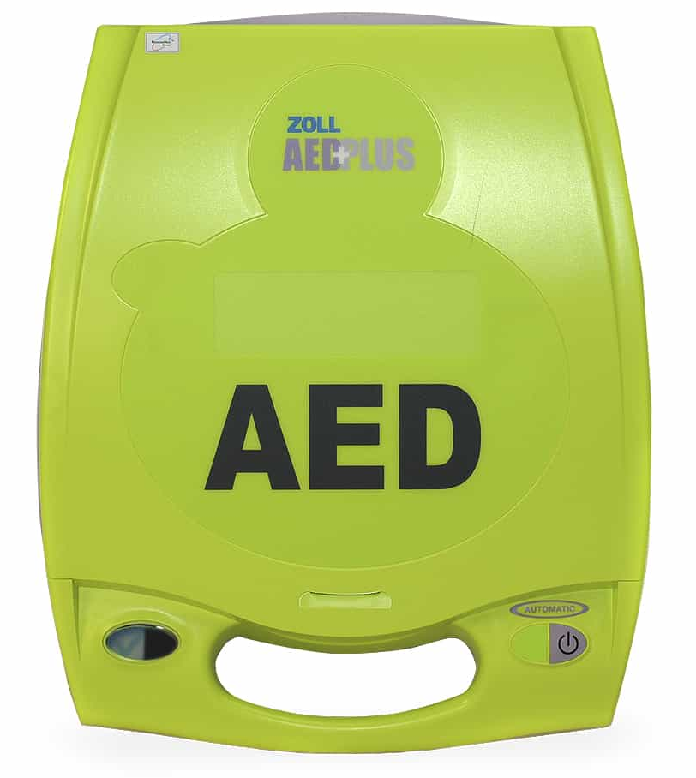
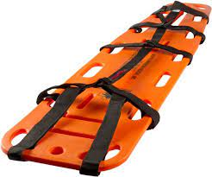
Emergency Equipment
Where is equipment stored?
Who is responsible for calibration(s)?
What equipment is available?
Ca Health and Safety Code
116045

Slide 19
Contact Information
Athletic Trainer
Athletic Director
Principal
Team Physician(s)
Area hospital(s)

Slide 20
Documentation
Who will complete needed documentation?
Evaluation forms
District reports
Timeline of care
Where will documentation be stored?

Slide 21
Who should make the EAP?
Stakeholders
All medical providers
Administration
Safety Officer

Slide 22
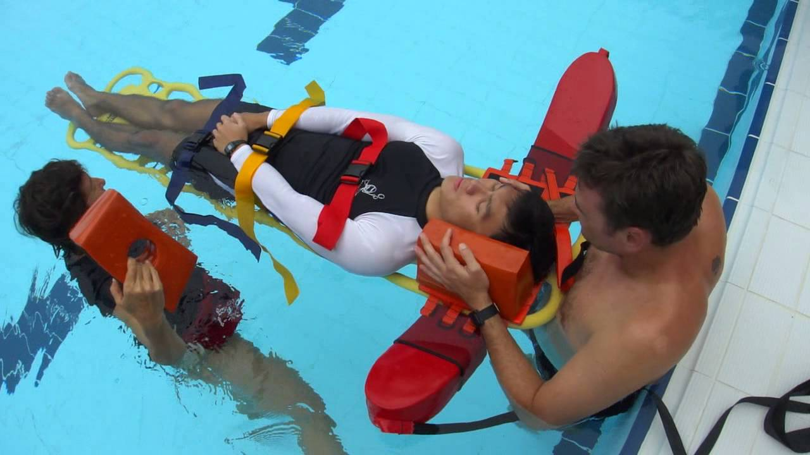
Special Considerations
Pool
Visiting Teams
Spectators
EMS Protocols

Slide 23
Now What?
PRACTICE!!!

Slide 24
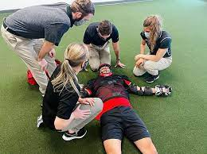
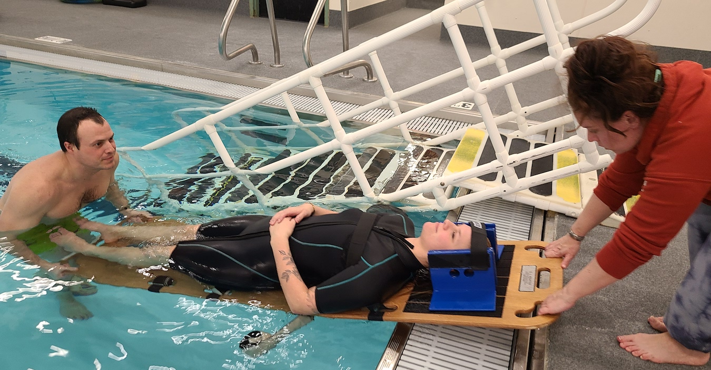
Practicing your EAP
Legal Step #2
Invite stakeholders
Walk through access points
K-I-S-S
Medical Time-out

Slide 25
Resources
Emergency Action Plan Templates:
Korey Stringer Institute
CDC
Mental Health
CIF Blue Book
CIF Templates

Slide 26
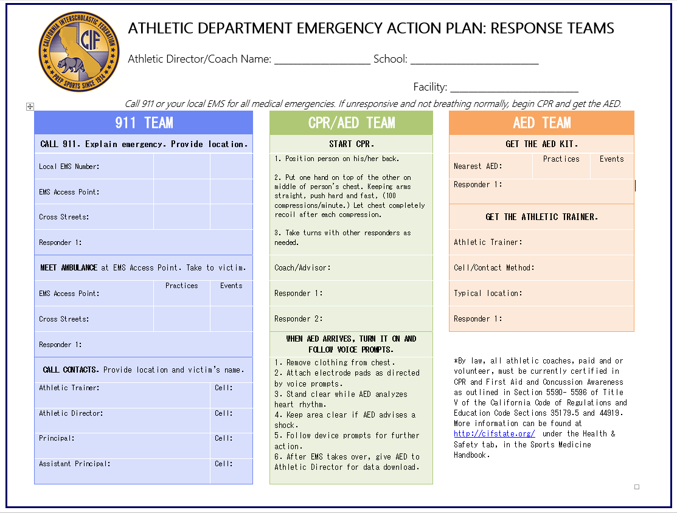

Slide 27
Questions?
Matt Quijano MA, ATC
matt.quijano@lmusd.org
805-903-3616

Slide 28
References
National Federation of State High School Associations. Emergency Action Plans: Practice Makes Perfect. 2021
National Athletic Trainers’ Association Position Statement: Emergency Planning in Athletics. 2002
National Athletic Trainers’ Association Emergency Action Plan Guidelines: Mental Health Emergency in Secondary School Athletes. 2016
National Alliance on Mental Health. Mental Health by the Numbers. June 2022
Centers For Disease Control and Prevention. Asthma in Children.
National Library of Medicine. Sudden Cardiac Death in Athletes. 2016
Centers For Disease Control and Prevention. Heat and Health Tracker.
Korey Stringer Institute. Traumatic Brain Injury.

