Slide 1
Servant Leadership by Jack Kocur 2023

Slide 2
What leaders do is they make situations and people better…At the end of the day, the essence of what they do is they strategically and practically…move people to be different.
—Randall Stutman

Slide 3
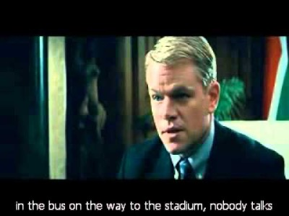

Slide 4
Serve Unto Others
It starts with YOU!!
Lead by EXAMPLE: to “SERVE”
Humble yourself: it is not about you, but those around you (sweep the sheds)
Choose your STYLE that helps you relate to others
To INSPIRED those around you to be better than they think they can be.
Find ways to help others ADAPT or/and Respond: “Using the work of others”
Fill your cup/jug Daily

Slide 5
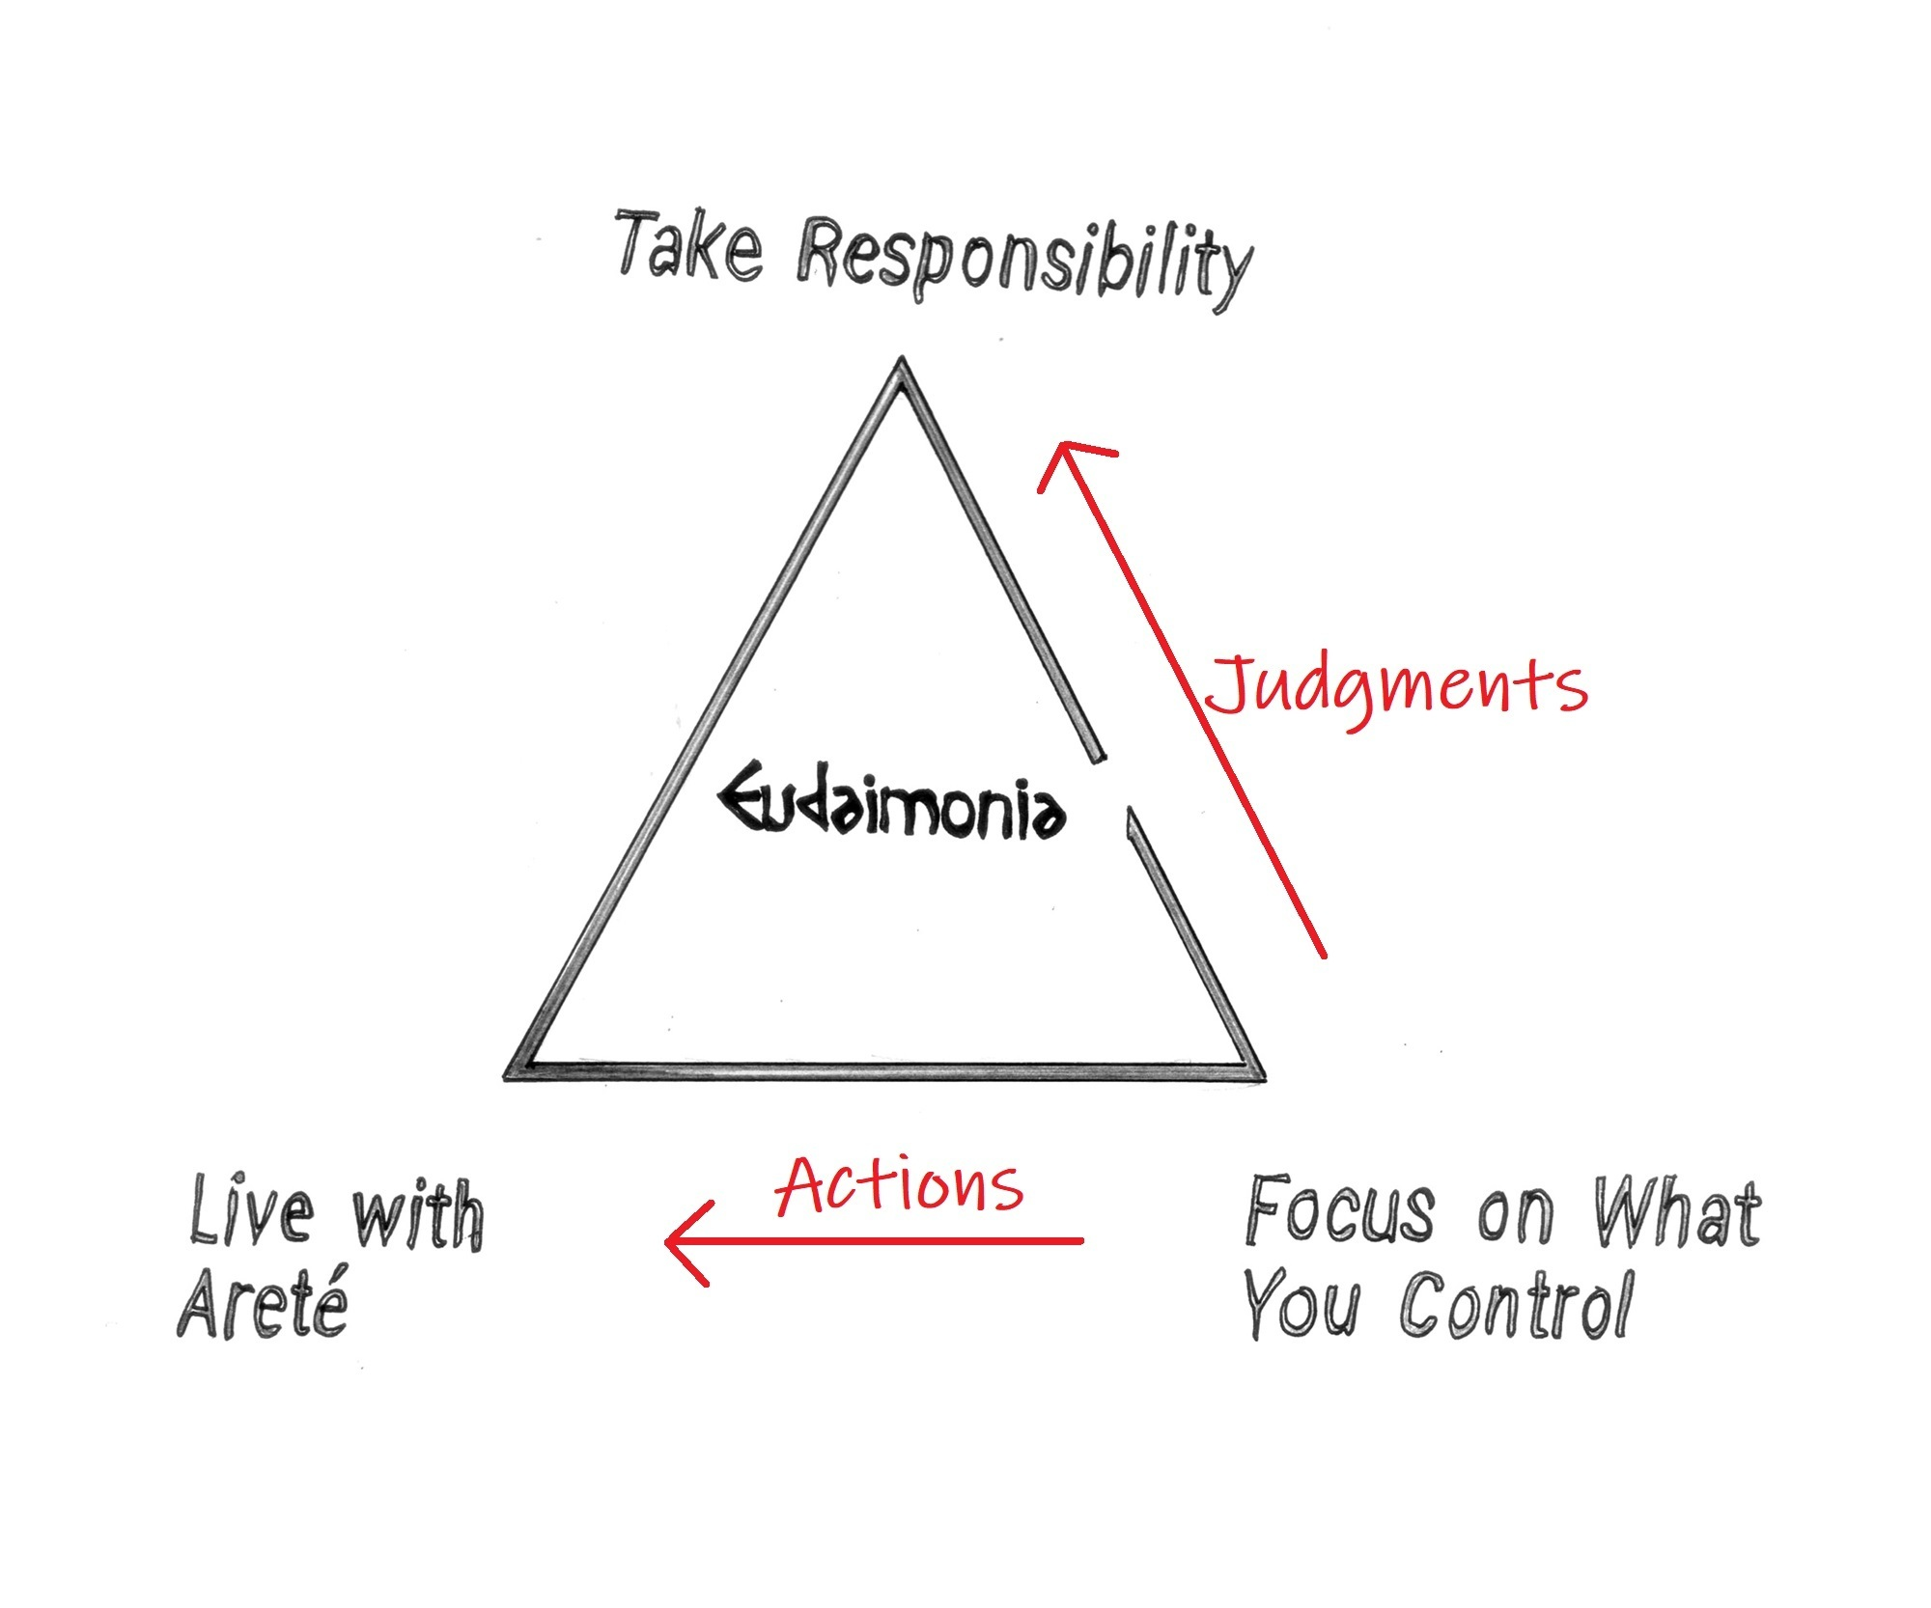
Arete vs Being Average
Are you Inspired?
Passion to be the/your Best!
Refers to "excellence" of any kind. The term may also mean "moral virtue”. Its this notion of excellence was ultimately bound up with the notion of the fulfillment of purpose or function: the act of living up to one’s FULL POTENTIAL!

Slide 7
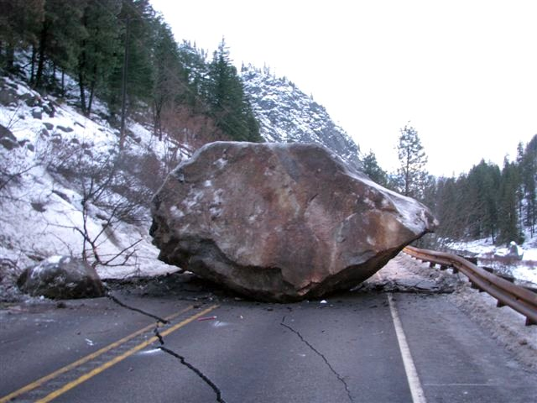
“The Obstacles Is The Way” by Ryan Holiday
What stands in the WAY becomes the WAY.
YOU get to decide, YOU get to choose, no one choices for YOU.
Embrace the struggle (challenges) and equipped yourself with the skills to be resilient.
How are you pouring into yourself ?
Collaborating
Reading
Music, video, movies, podcast
Working out
Mentors

Slide 8
CONNECTION before DIRECTION!
Develop a Relationship and Connect with those you are leading.
WHY are they there?
What is their PURPOSE?
Help them find their love or PASSION for what they are doing.
Create a safe space for CONVERSATION outside of work-related topics.
Give Empathy to others (different generations)
Build TRUST, without it, they will never sacrifice themselves for the team.
Invest in who they are, and they will return the investment back to the Team

Slide 9
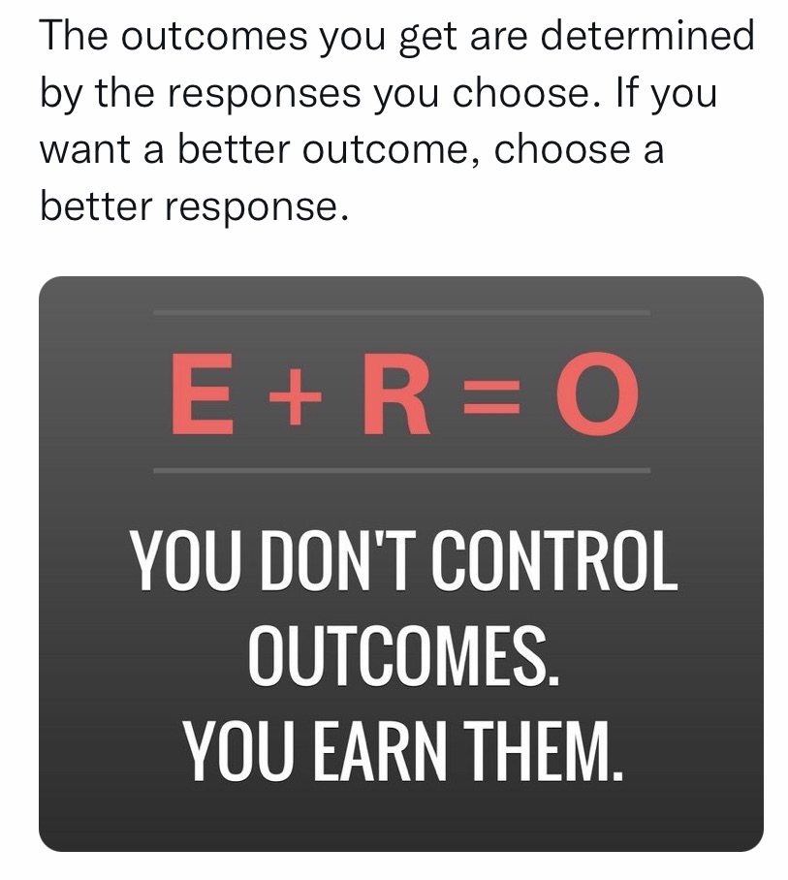
Help Guide Their BEHAVIOR
Performance = capability + BEHAVIOR
The way you behave will bring out the best and worst of your capability
The Response falls into 2 types of Behaviors
Positive
Kind
Hardworking - Energized
Empathy
Confident
Respectful
Service
Negative
Angry
Bossy
Lack energy
Grumpy and Moody
Know-it-all
Selfish

Slide 10
Change Your Outlook

Slide 11
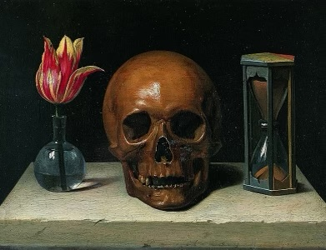
Memento Mori
Remember I will Die, so live in the moment!

Slide 12
