Slide 1
CIF Southern Section Eligibility Seminar
Athletic Administrators Summit
October 9, 2023

Slide 2
Agenda
Welcome + Introductions - Mike West, Commissioner of Athletics
Students Changing Schools – Rich Shearer, Asst. Commissioner
Transfer Flow Chart/Hardships – Kristine Palle, Asst. Commissioner
International Students – Mike Middlebrook, Asst. Commissioner
Misconducts/Sportsmanship – Thom Simmons, Asst. Commissioner
A Process on your Campus – Jerry De Fabiis, Asst. Commissioner
MVP AD Exam – Mike West, Commissioner of Athletics
Questions and Answers - Attendees

Slide 3
When a Student Changes Schools
Valid Change of Residence
Transfer
Hardship

Slide 4
Valid Residence Change Definition
A valid residence is defined as the location where the student’s parent(s)/guardian(s)/caregiver (with whom eligibility has been established) live with that student and thereby have the use and enjoyment of that location as a residence. A valid change of residence for eligibility purposes requires the former residence to have been vacated by the entire family for use as its residence. For athletic eligibility purposes, a student (with the student’s parent(s)/guardian(s)/caregiver with whom residential eligibility has been established) may only have one primary valid residence at one time.

Slide 5
Valid Residence Change Definition
A valid change of residence must be made FROM a residence located in the public high school attendance area, (School A’s attendance area) even if the student is not currently attending nor ever has attended the school in which attendance area they reside, TO another public high school’s attendance area (School B’s attendance area).
- Full family unit including school aged children
- Permanent intent and genuine, without fraud or deceit
- Current Issues that we are seeing – former residence, fabricated documents, etc.

Slide 6
Transfer – Switching Schools Without a VCR or Approved Hardship
SOP- on all first-time transfers, regardless of sport participation at former school
Lower Levels- full season participation but no varsity level competition
Varsity level competition but only after sit out period date for sport (no prior sport participation at a lower level that season)

Slide 7
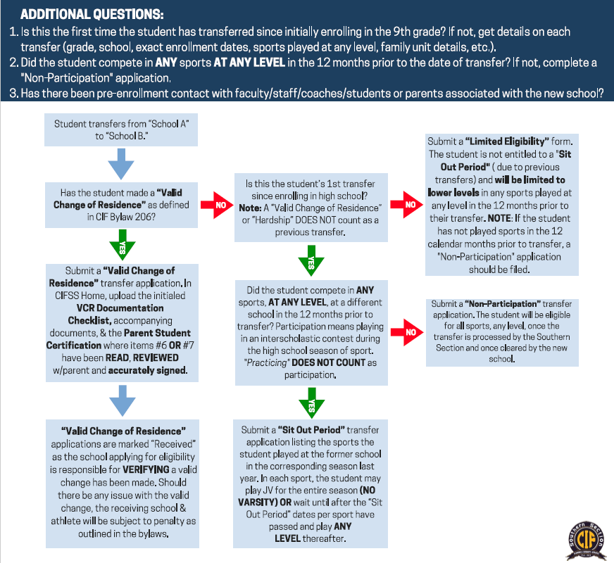
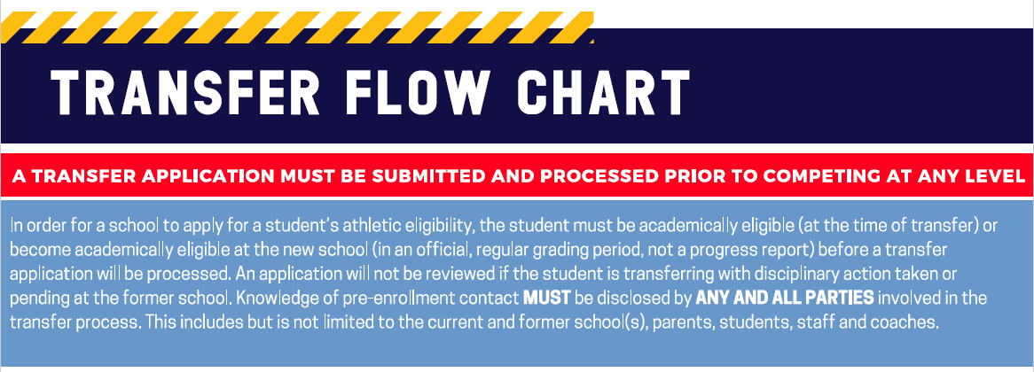
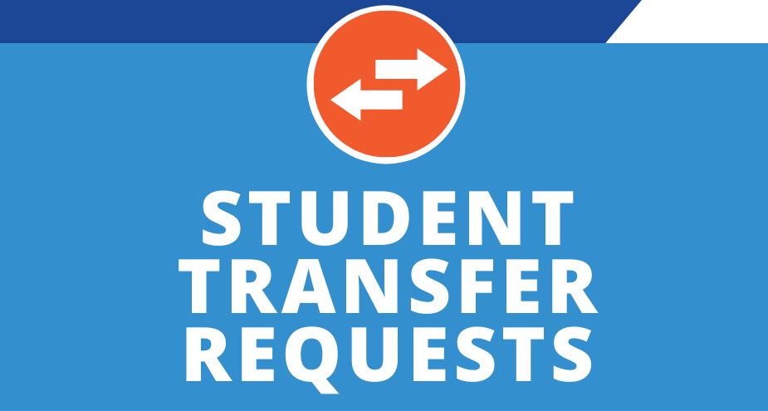
Transfer Eligibility Flow Chart

Slide 8
Limited Eligibility
Multiple transfers with no VCR or approved Hardship
Lower-level sport participation only in affected sports (those played at another school within the past 12 months)

Slide 9
Hardship
Specific categories that may apply for Hardship are located on pages 83-85 of CIF-SS Blue Book
Review those categories prior to submission into CIFSSHOME
20 business days to process
Must include corroborating documentation

Slide 10
International Students Foreign Exchange or International, Ask the Right Questions

Slide 11
Bylaw 503M Statewide Ejection Policy
Players Ejected for fighting/assaultive behavior/gross unsportsmanlike behavior (3-6 games). Players may attend in street clothes the games they are suspended for.
Coaches Ejected for fighting/assaultive behavior/gross unsportsmanlike behavior (3-6 games).
Spectator Ejections
Appeals only for multi-game ejections per bylaw 503M. Misidentification or incorrect rule application only allowable reasons for appeal.

Slide 12
Transfer Eligibility Process
Your Team
Registrar
Guidance Department
Secretary
Coaching Staff
YOU ARE THE CAPTAIN
YOU SET THE CULTURE FOR HOW THE TEAM PARTICIPATES IN THE PROCESS
Key Components of your process
Identification of students
-registration day
-enrollment
-academic schedules
-team meetings
-rosters
Documentation
- academic
- residential
- discipline

Slide 13
MVP AD EXAM
The Exam is ONLINE and will be Live from:
Monday, October 9th @ 4:00 pm thru Sunday, October 15th @ 11:59 pm
Your Test will Automatically Be Scored
The MVP AD EXAM can be found at
www.cifss.org under the AD Summit Tab
Testing Window Opens Tonight!

Slide 14
Questions?

