Slide 1
2023 NFHS Softball Rules PowerPoint
Rules Changes
Major Editorial Changes
Points of Emphasis

Slide 2
Guidelines for Schools and state associations for consideration of accommodations
Request of Accommodation by School
State/Local Office Review
Written Determination from State/Local Office
Competition with Approval of Accommodation. Must be available at the game.
Notes:
To assist state associations in working with schools for the inclusion of students with disabilities the following guide prepared by the NFHS Task Force on the Inclusion of Students with Disabilities is being provided for your review.
Following these guidelines will assist in the individual student assessment by the student and the school.
When requesting a possible accommodation, coaches should work with their school and the state association as early as possible in the sport season.
Contest officials shall defer decisions on rule accommodations to the respective state association.
This information serves as a guide. Each state association may develop its own process.

Slide 3
2023 nfhs softball RULES CHANGES

Slide 4
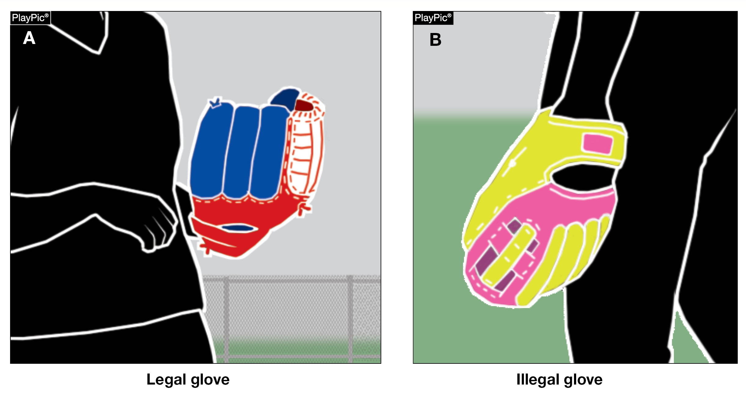
Gloves/mitts rule 1-4-1a, b (pg. 12)
Gloves/mitts are now permitted to be more than two colors. Gloves/mitts, lacing and seams still may not be the color of the ball.
The glove still cannot have an optic-colored marking which gives the appearance of the ball or is judged to be distracting to the umpire.
Notes:
Rule 1-4-1a, b: Gloves/mitts are now permitted to be more than two colors. Gloves/mitts, lacing and seams still may not be the color of the ball.
Rationale: The rule change removes the number of color restrictions on the glove, including laces and seams, but does not permit any part of the glove to match the color of the ball. This change allows for the rule to be less restrictive, providing more options. The glove still cannot have an optic-colored marking which gives the appearance of the ball or is judged to be distracting to the umpire.

Slide 5
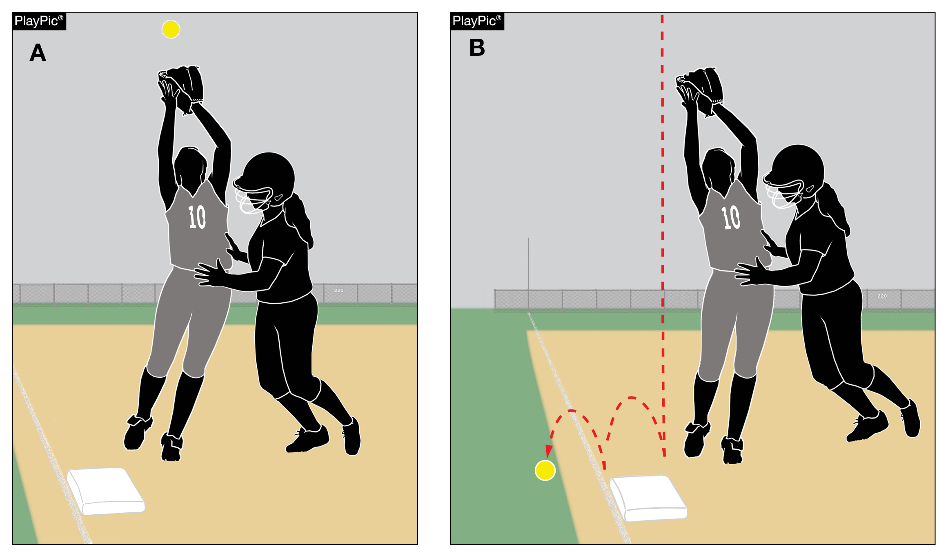
Fair ball rule 2-20-1g (NEW) (pg. 22)
If an offensive player interferes with a defensive player attempting to field a batted ball while the ball is over fair territory, it is a fair ball.
This change allows the definition of a fair ball to reflect what umpires have always enforced as part of the definition of a fair ball. It is intended to mirror the definition of a foul ball. (2-25-1e)
Notes:
Rule 2-20-1g (NEW): If an offensive player interferes with a defensive player attempting to field a batted ball while the ball is over fair territory, it is a fair ball.
Rationale: This change allows the definition of a fair ball to reflect what umpires have always enforced as part of the definition of a fair ball. It is intended to mirror the definition of a foul ball. (2-25-1e)

Slide 6
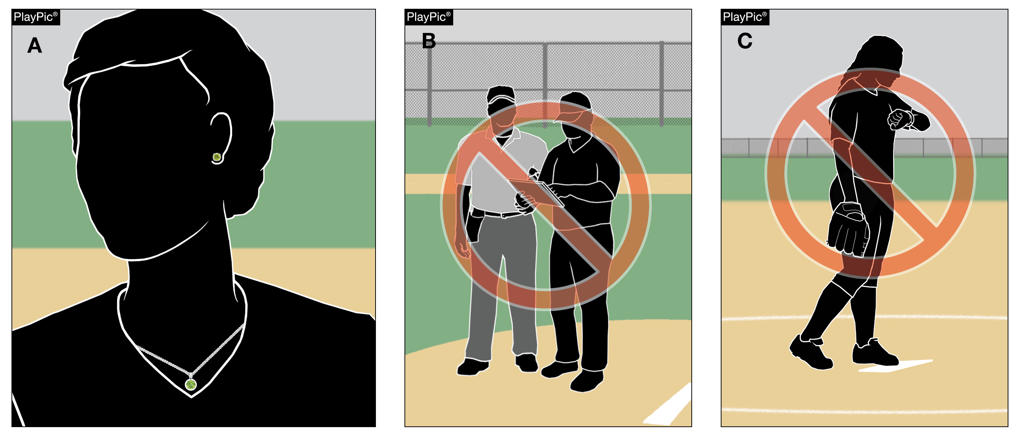
UNIFORMS, PLAYER EQUIPMENT rules 3-6-11 (pg. 39)
Jewelry is no longer prohibited. However, Rule 1-8-6 is still in effect, which prohibits team personnel from using electronic devices to communicate or transmit data outside of the dugout.
DO NOT go looking for jewelry!
Umpires still have the authority to rule on anything that is considered a distraction or increases risk to any player.
Notes:
Rules 3-6-11: Jewelry is no longer prohibited. However, 1-8-6 is still in effect, which prohibits team personnel from using electronic devices to communicate or transmit data outside of the dugout.
Rationale: The NFHS Softball Committee removed the former Rule 3-2-12 prohibiting jewelry, which places the softball rules in line with other NFHS sports that do not have the restriction. These sports have no documented data of an increased risk for injury while wearing jewelry. With this change, medical alert and religious medals are no longer a concern. Umpires still have the authority to rule on anything that is considered a distraction or increases risk to any player.

Slide 7
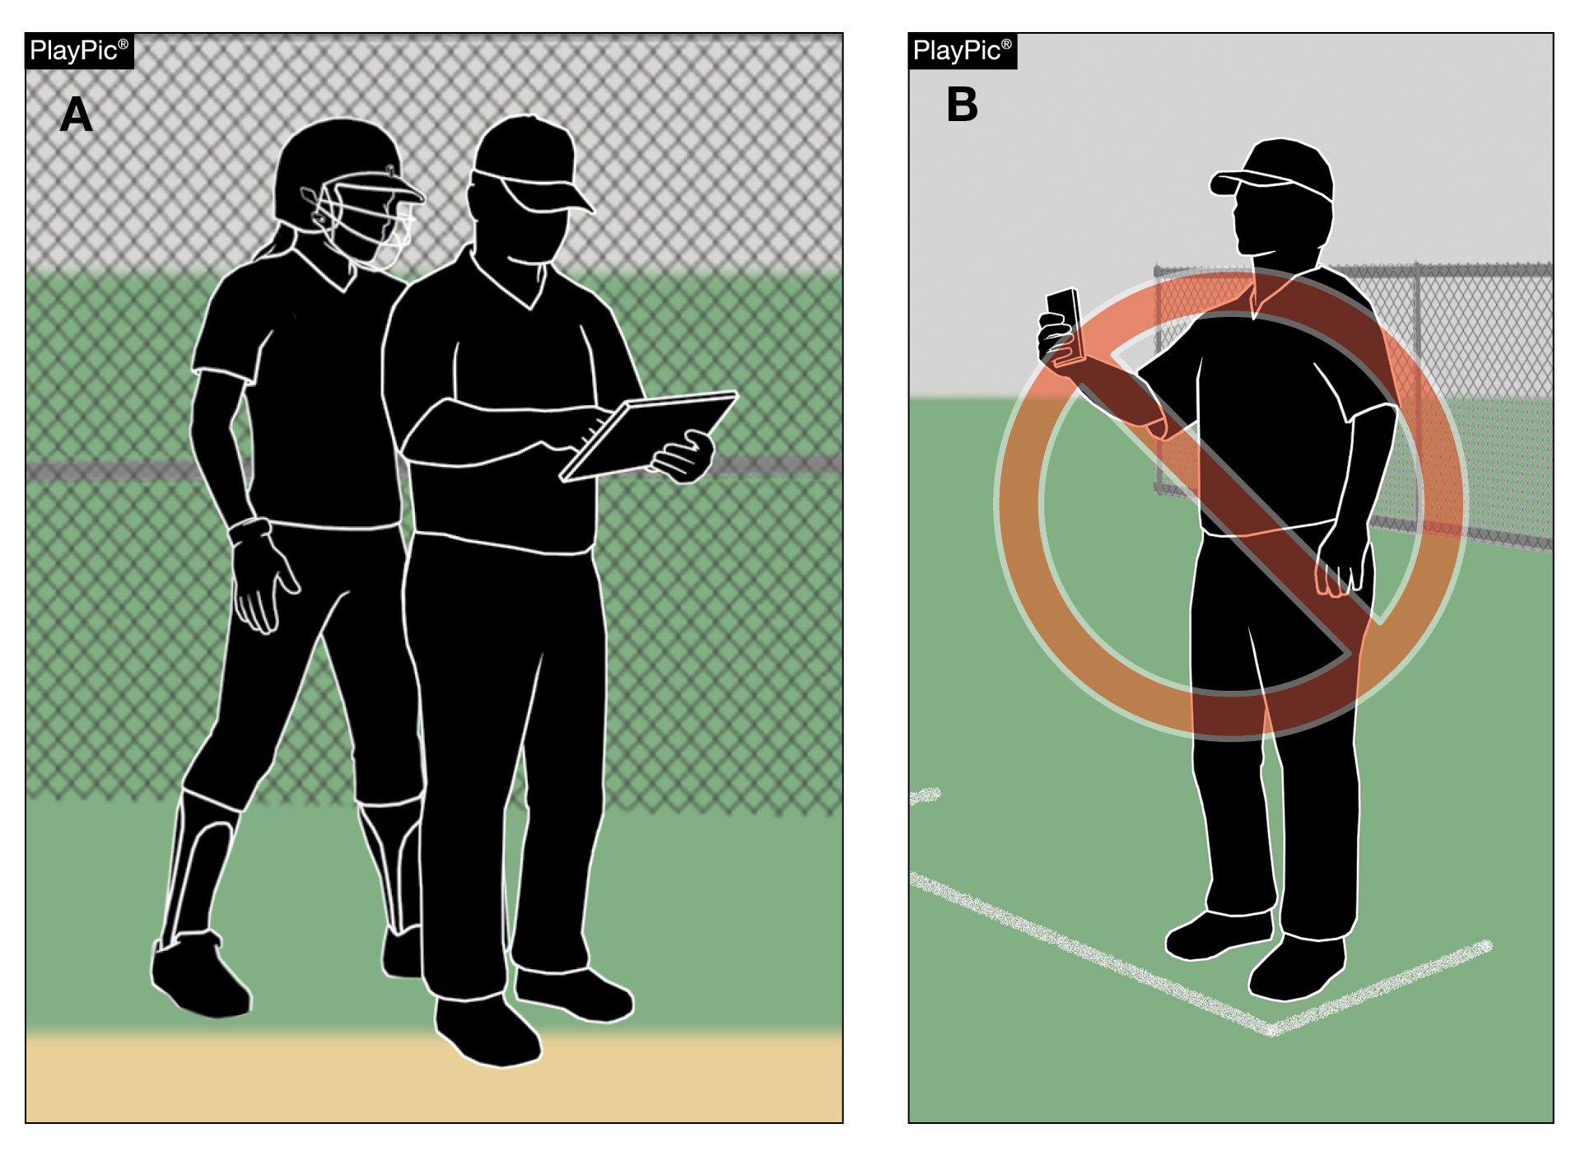
Bench and field conduct rule 3-6-11 (pg. 39)
Clarifies where electronic devices may be used for coaching purposes during a game.
The use of electronic devices by team personnel to transmit or record information pertaining to their players or team’s performance is only permitted within the dugout.
Notes:
Rule 3-6-11: Clarifies where electronic devices may be used for coaching purposes during a game.
Rationale: The rule prohibiting jewelry has been removed, allowing team personnel to now wear jewelry; however, the rule regarding the use of electronics is still in place. The use of electronic devices by team personnel to transmit or record information pertaining to their players or team’s performance is only permitted within the dugout. Items such as smartwatches are permitted to be utilized as a watch but cannot be used to transmit or receive data outside of the dugout.

Slide 8
2023 NFHS Softball Rules PowerPoint
Rules Changes
Major Editorial Changes
Points of Emphasis

Slide 9
Bench and field conduct rule 3-6-11
Clarifies where electronic devices may be used for coaching purposes during a game.
Items such as smartwatches are permitted to be utilized as a watch but cannot be used to transmit or receive data from outside of the dugout.
Notes:
Rule 3-6-11: Clarifies where electronic devices may be used for coaching purposes during a game.
Rationale: The rule prohibiting jewelry has been removed, allowing team personnel to now wear jewelry; however, the rule regarding the use of electronics is still in place. The use of electronic devices by team personnel to transmit or record information pertaining to their players or team’s performance is only permitted within the dugout. Items such as smartwatches are permitted to be utilized as a watch but cannot be used to transmit or receive data outside of the dugout.

Slide 10
Bench and field conduct rule 3-6-11
IMPROPER CONDUCT PENALTY SUMMARY CHART
Penalty | Infraction | Additional Info
Ejection Unless judged to be of a minor offense. If minor, offender is warned and ejected if repeated. | Electronic communication devices (3-6-11). Use of tobacco products (3-6-12) Unsporting acts (3-6-13) Charging an umpire (3-6-14) Arguing balls and strikes or judgement calls (3-6-15). Deliberately throwing equipment (3-6-16) | 1 and 3. Coaches who violate may be restricted or ejected (3-6-11, 3-6-13).

Slide 11
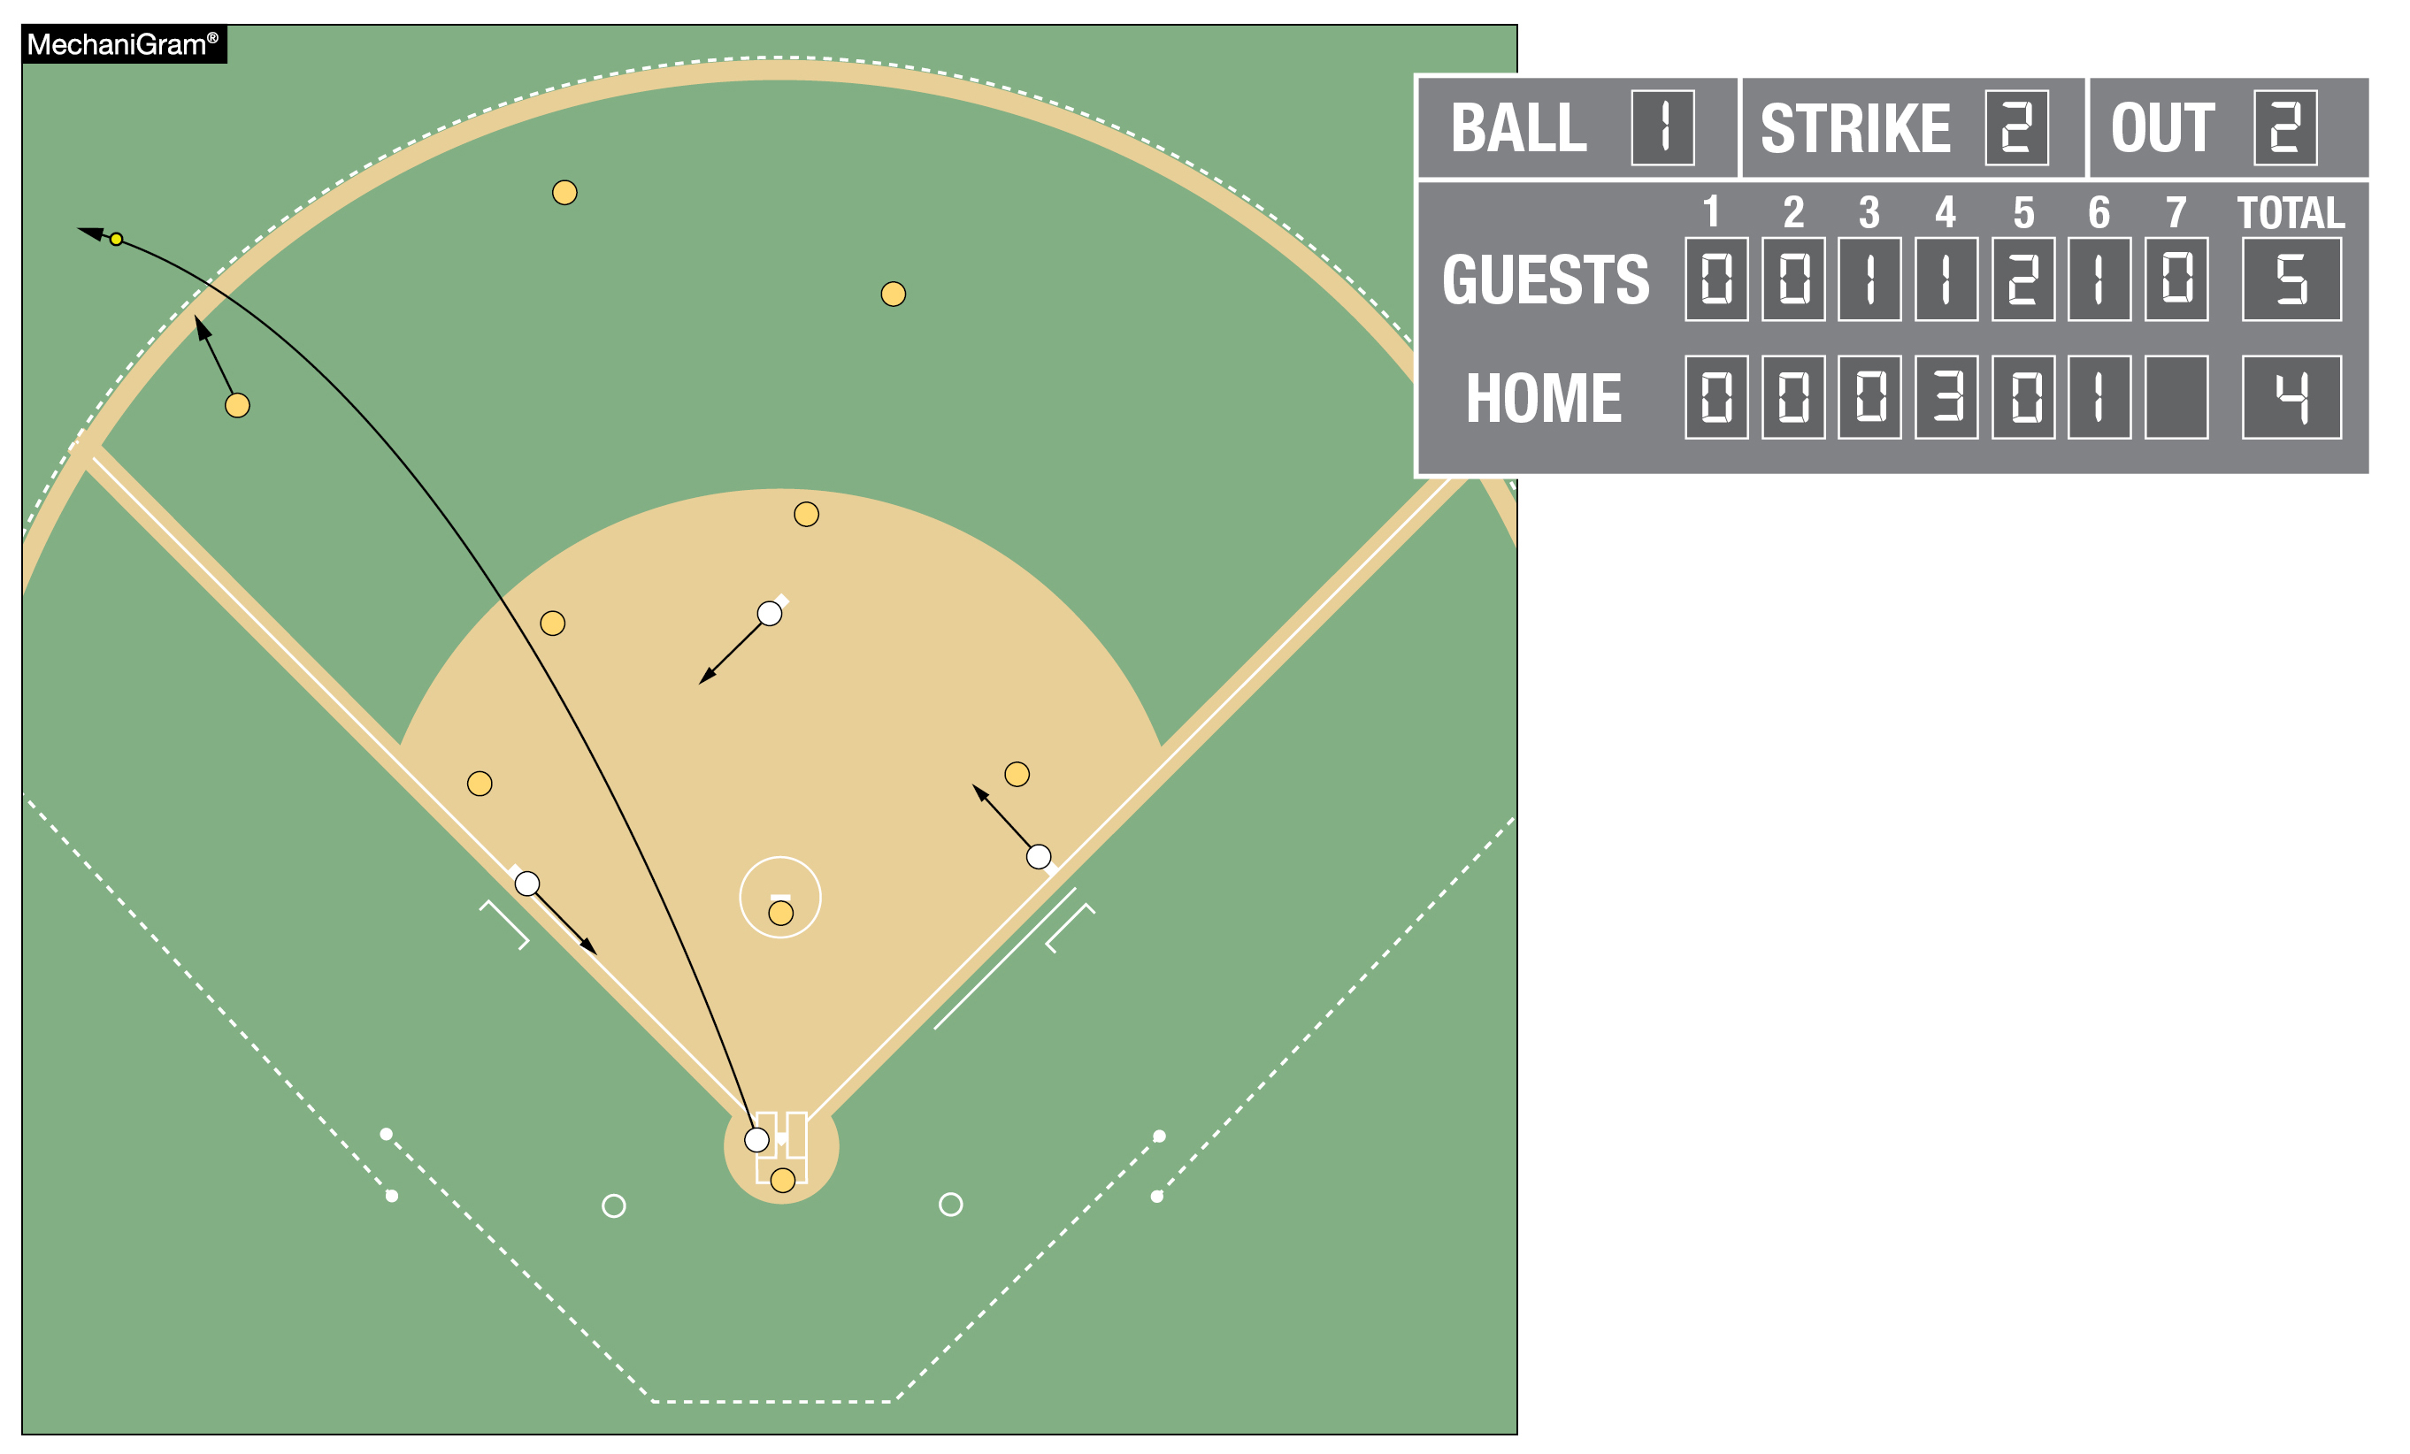
Ending a game rule 4-2-1 (pg. 42)
Allows for all runs to be counted when a fair batted ball clears the home run fence to end the game.
Notes:
Rule 4-2-1: Allows for all runs to be counted when a fair batted ball clears the home run fence to end the game.
Rationale: All runs scored by virtue of the home run will be included in individual and team statistics.

Slide 12
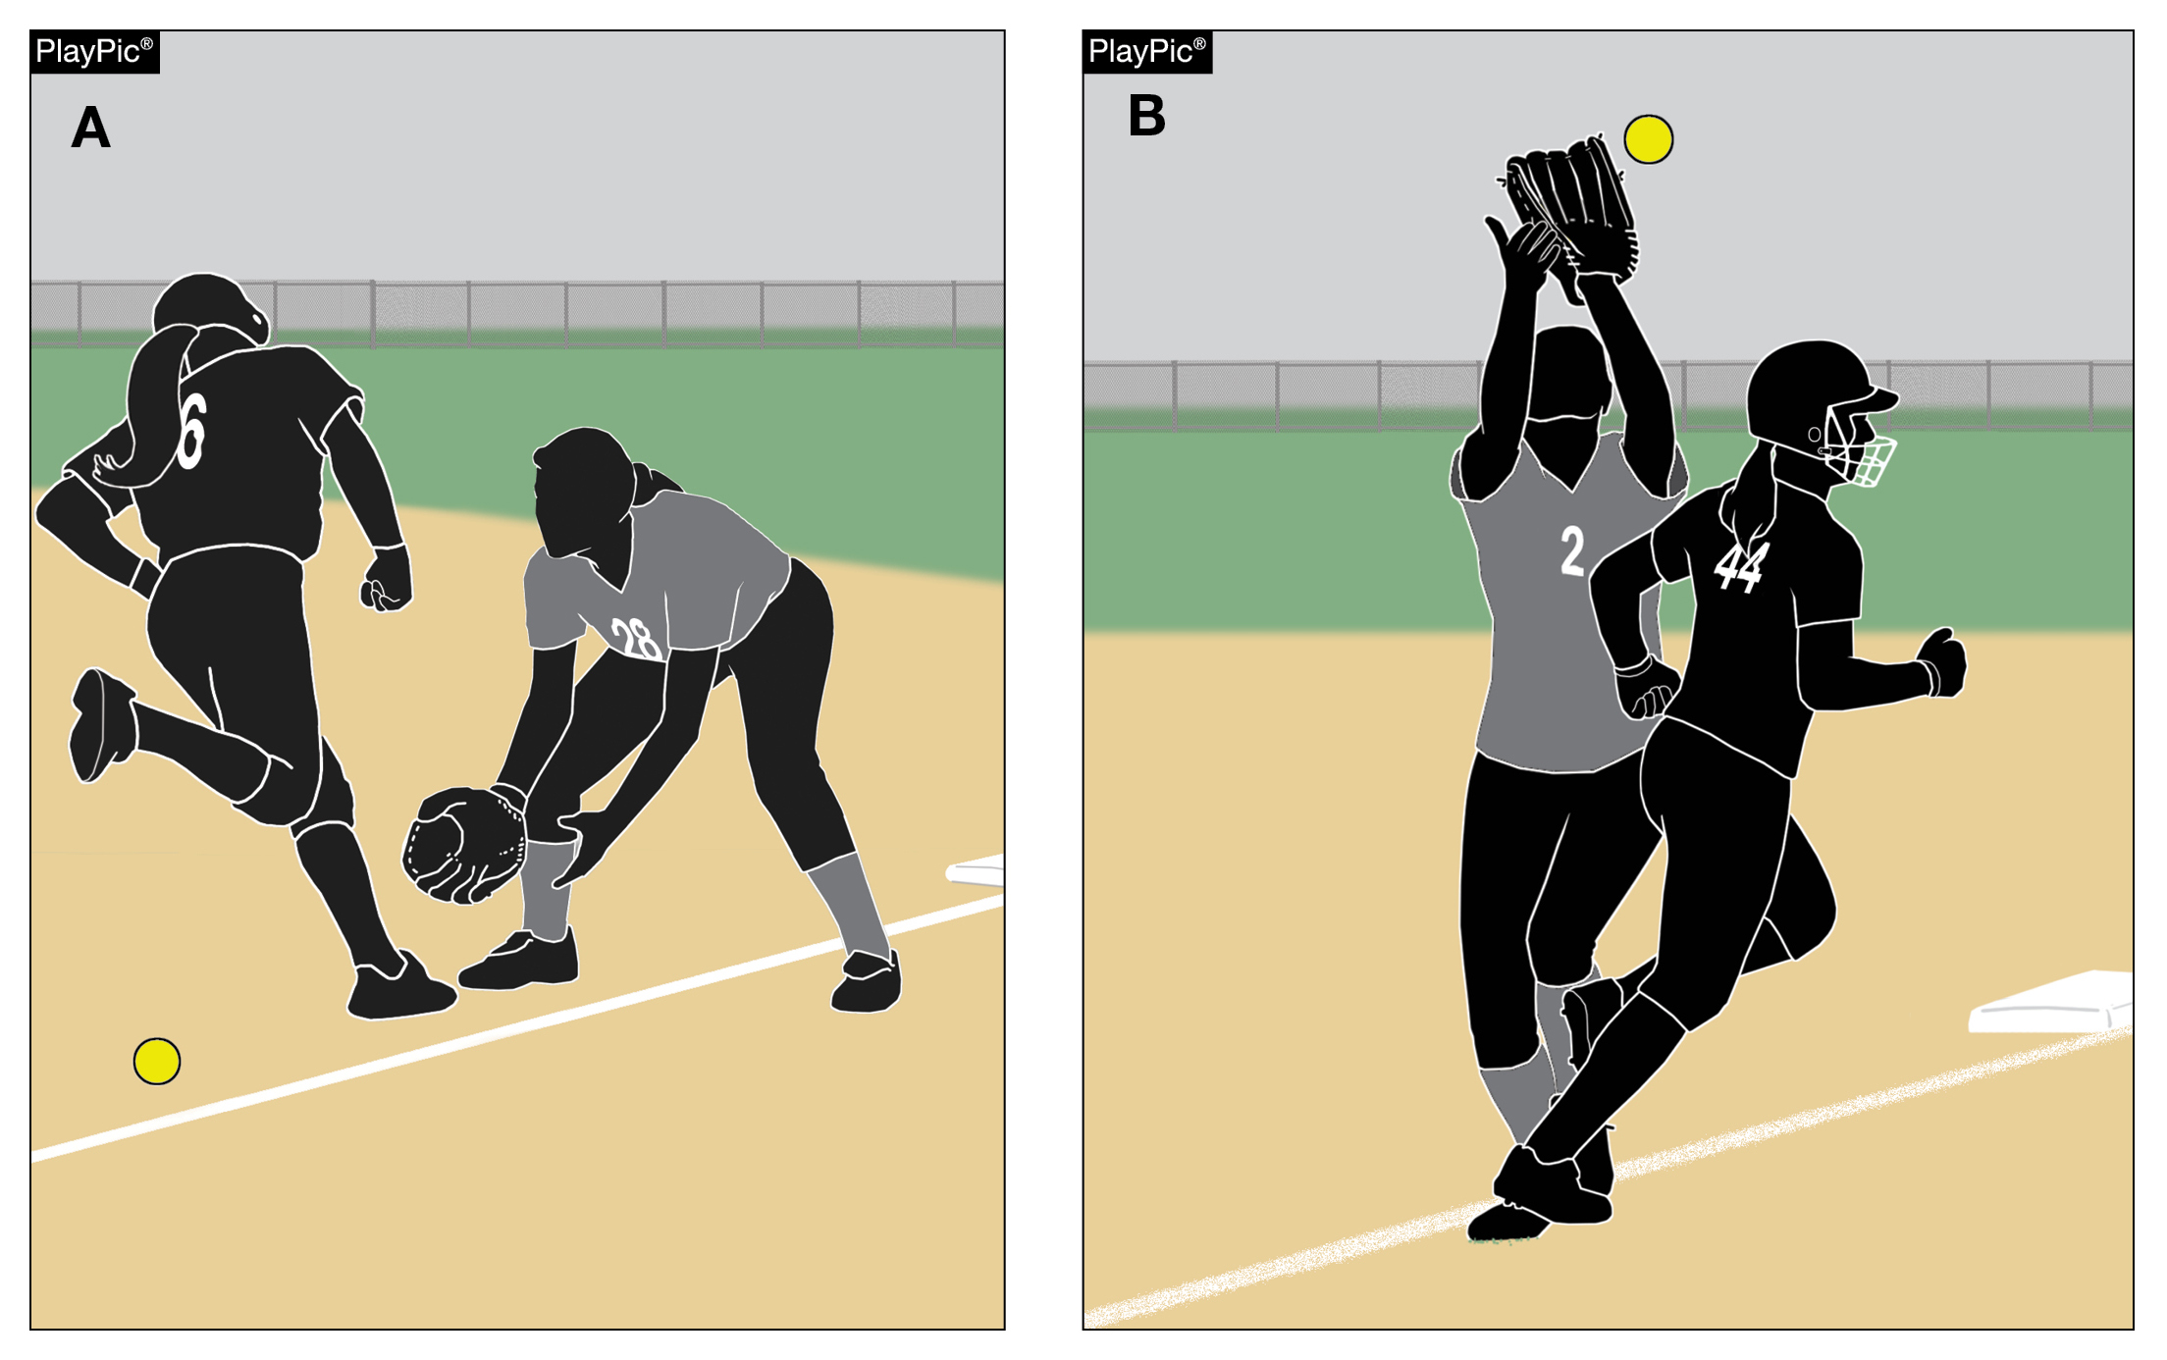
Batter-runner is out rule 8-2-7 (pg. 64)
Clarifies and further defines what constitutes batter-runner interference; including while a fielder is attempting to field a fly ball over foul territory.
The language is consistent with the rule covering interference on an initial play on a fair-batted ball and aligns with Rule 8-6-10.
Notes:
Rule 8-2-7: This clarifies batter-runner interference on a fly ball over foul territory.
Rationale: This has always been the enforcement but was not listed in the section covering batter-runner. The language is consistent with the rule covering interference on an initial play on a fair-batted ball and aligns with Rule 8-6-10.

Slide 13
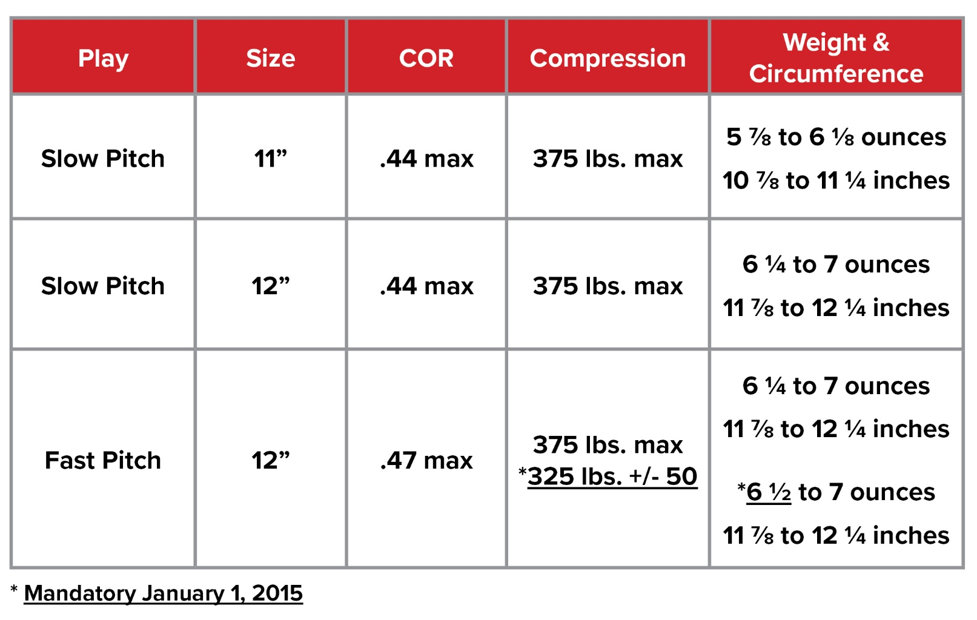
softballs Rule 1-3-3 (pg. 11)
The new ball specifications are permissible currently and will be required January 1, 2025, for high school competition.
Balls manufactured with the current specifications will be permitted for use through 2024.
*Mandatory January 1, 2025
Notes:
Rule 1-3-3
The new ball specifications are permissible currently and will be required January 1, 2025, for high school competition.
Balls manufactured with the current specifications will be permitted for use through 2024.
Rationale: Ball tolerance specifications for the 12-inch Fast Pitch Softball have been standardized for NFHS, NCAA, and USA Softball. After conducting research on whether the minimal changes might have an impact on safety, it was determined that changing the weight from 6¼ to 6½ ounces would not increase batted ball speed. Any balls manufactured with the former specifications will be permitted through 2024, to allow for state associations manufacturers to reduce current inventory. The new ball specifications are permitted for use during the 2021-22 season and will be required by January 1, 2025.

Slide 14
2023 nfhs softball editorial CHANGES

Slide 15
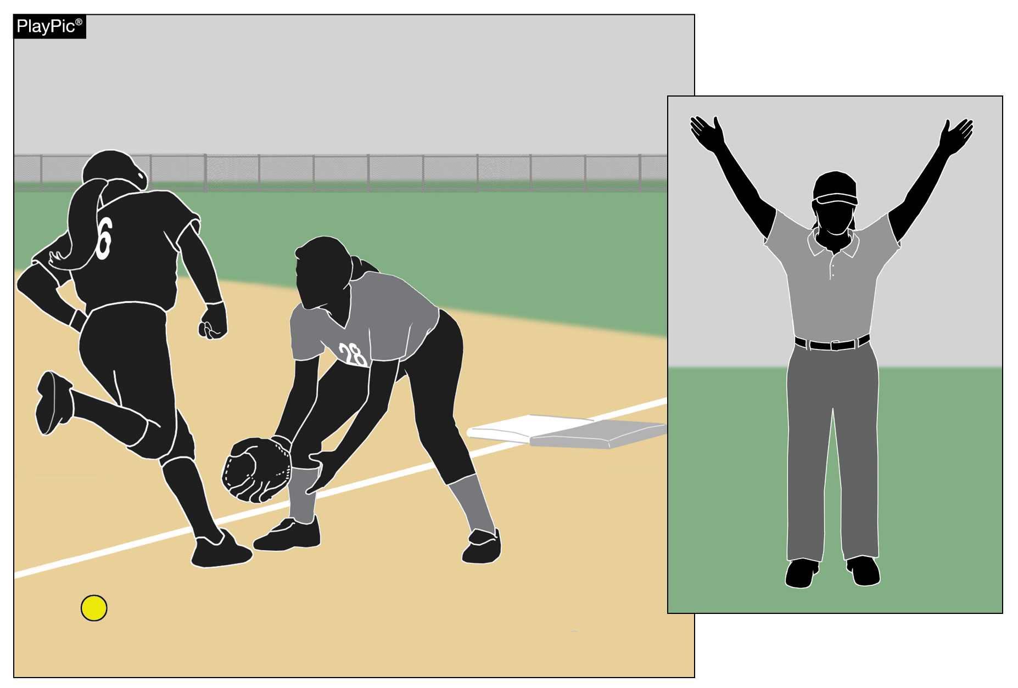
Foul, foul tip rule 2-25-1e (pg. 23)
While over foul territory, an offensive player a runner interferes with a defensive player attempting to field a batted ball.
Clearly defines that any offensive player can commit interference on a batted ball while over foul territory.
Notes:
Rule 2-25-1e: While over foul territory, an offensive player a runner interferes with a defensive player attempting to field a batted ball.
Rationale: Clearly defines that any offensive player can commit interference on a batted ball while over foul territory. This has always been the enforcement but by changing the word from runner to offensive player it makes the rule more inclusive and easily interpreted.

Slide 16
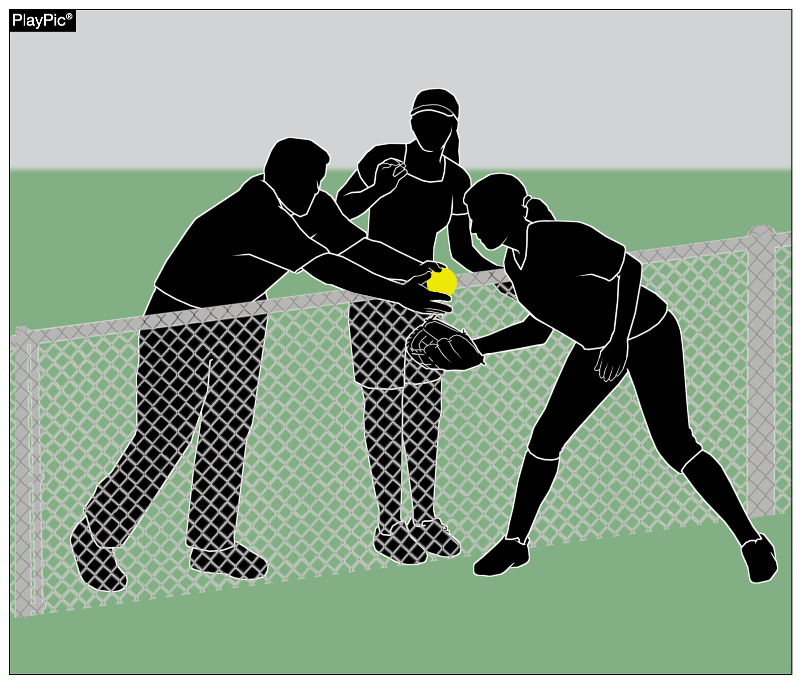
Batter is out rule 7-4-11 (pg. 60)
When a spectator reaches into live ball territory and interferes with a fielder’s opportunity to catch a fly ball. A fair or foul (other than a foul tip, not a third strike) ball is caught in flight by a fielder or such catch is prevented by a spectator reaching into the playing area.
Notes:
Rule 7-4-11: When a spectator reaches into live ball territory and interferes with a fielder’s opportunity to catch a fly ball. A fair or foul (other than a foul tip, not a third strike) ball is caught in flight by a fielder or such catch is prevented by a spectator reaching into the playing area.
Rationale: This better defines spectator interference on a fair or foul fly ball. The previous rule language was confusing on a fly ball when there was spectator interference preventing the defense from catching the ball.

Slide 17
2023 nfhs softball points of emphasis

Slide 18
Sportsmanship (pg. 86/87)
NFHS playing rules are written to encourage sportsmanship. Participation in these programs should promote respect, integrity and sportsmanship.
However, for these ideals to occur, everyone involved in these programs must be doing their part.
Notes:
Sportsmanship Good sporting behavior is one of the fundamental ingredients to the continued success and enjoyment of education-based high school sports and activities. In fact, in the 103-year history of organized high school sports in the United States, good sportsmanship has been one of the most important outcomes of high school activity programs. NFHS playing rules are written to encourage sportsmanship. Participation in these programs should promote respect, integrity and sportsmanship. However, for these ideals to occur, everyone involved in these programs must be doing their part.

Slide 19
sportsmanship
There must be a collaborative, working relationship between contest officials and game administration to promote good sportsmanship and safely conduct the contest.
Everyone has their roles to play in creating a positive, sportsmanlike atmosphere at contests.
Notes:
Sportsmanship The NFHS is concerned that unsporting behavior in education-based athletics has increased across all sports. As a result, the NFHS has made sportsmanship the No. 1 Point of Emphasis for the 2022-23 school year. Sportsmanship, or good sporting behavior, is about treating one another with respect and exhibiting appropriate behavior. It is about being fair, honest and caring. When these types of appropriate behavior occur, competitive play is more enjoyable for everyone. Coaches set the tone at athletic contests with their display of sportsmanship. If these individuals act in a sportsmanlike manner, their behavior sets the tone for players, spectators and others. If coaches, however, are complaining constantly about the decision of contest officials, spectators are more likely to do the same. There must be a collaborative, working relationship between contest officials and game administration to promote good sportsmanship and safely conduct the contest. Everyone has their roles to play in creating a positive, sportsmanlike atmosphere at contests.

Slide 20
sportsmanship
Contest officials should never engage with spectators who are exhibiting unsporting behavior.
Once the contest begins, school administration is responsible for dealing with unruly spectators.
If spectators are using demeaning or profane language at officials – or at others in the stands – those individuals should be removed from the contest by school administration.
Notes:
Sportsmanship Officials should focus on the actions of players, coaches and other bench/sideline personnel. A positive, open line of communication between officials and coaches ultimately results in a better contest for everyone involved. Contest officials, however, should never engage with spectators who are exhibiting unsporting behavior. Once the contest begins, school administration is responsible for dealing with unruly spectators. A proactive approach by school administration includes monitoring the behavior of spectators and intervening as needed. If spectators are using demeaning or profane language at officials – or at others in the stands – those individuals should be removed from the contest by school administration.

Slide 21
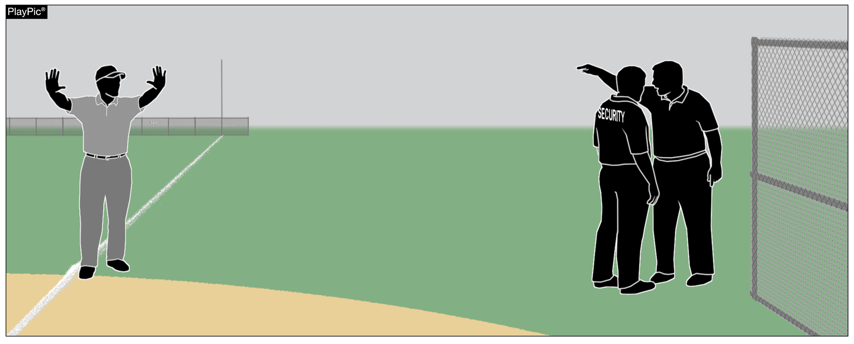
sportsmanship
Good sports win with humility, lose with grace and do both with dignity.
It takes the efforts of everyone every day to ensure that sportsmanship remains one of the top priorities in education-based activity programs.
Notes:
Sportsmanship A proactive approach by school administration includes monitoring the behavior of spectators and intervening as needed. If spectators are using demeaning or profane language at officials – or at others in the stands – those individuals should be removed from the contest by school administration. In recent years, a heightened level of unsportsmanlike behavior has been occurring by spectators at high school sporting events, and it must be stopped. The use of demeaning language, or hate speech, by students, parents and other fans must cease. High school sports and other activities exist to lift people up, not demean or tear people down. The goal is to treat everyone fairly and treat each other with respect. Any speech or harassment that is insulting, demeaning or hurtful will not be tolerated. High schools must establish a culture that values the worth of every single person – both players on the school’s team and players on the opposing team. There must be a no-tolerance policy regarding behavior that shows disrespect for another individual. Good sports win with humility, lose with grace and do both with dignity. It takes the efforts of everyone every day to ensure that sportsmanship remains one of the top priorities in education-based activity programs.

Slide 22
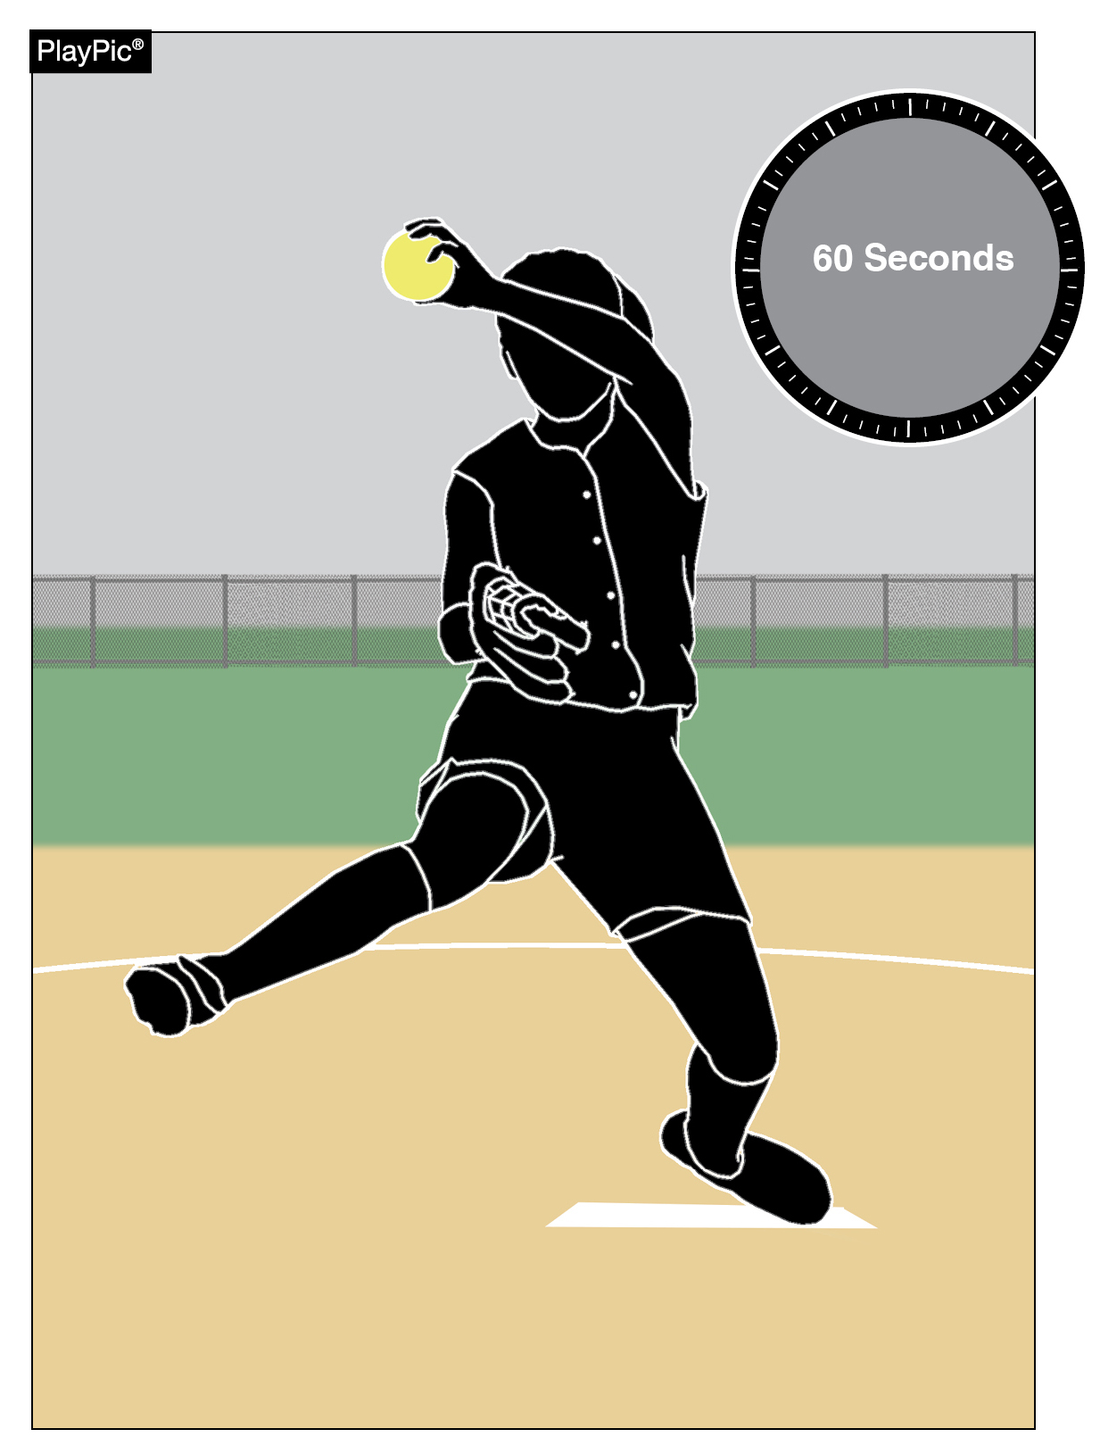
Time between innings
Umpires and coaches should pay strict attention to the 60-second time limit between half-innings.
At the beginning of each half-inning no more than one minute may be used to deliver no more than five pitches to the catcher or other teammate.
The one-minute time limit begins from the third out of the previous half-inning.
A pitcher returning to the pitching position in the same half inning will not be granted any warm-up pitches.
Umpires may authorize more pitches during inclement weather or if a pitcher was removed due to injury or by rule.
Notes:
TIME BETWEEN INNINGS As a point of emphasis umpires and coaches should pay strict attention to the 60 second time limit between half-innings. In accordance with Rule 6-2-5 at the beginning of each half-inning no more than one minute may be used to deliver no more than five pitches to the catcher or other teammate. The one-minute time limit begins from the third out of the previous half-inning. A pitcher returning to the pitching position in the same half inning will not be granted any warm-up pitches. Umpires may authorize more pitches during inclement weather or if a pitcher was removed due to injury or by rule.

Slide 23
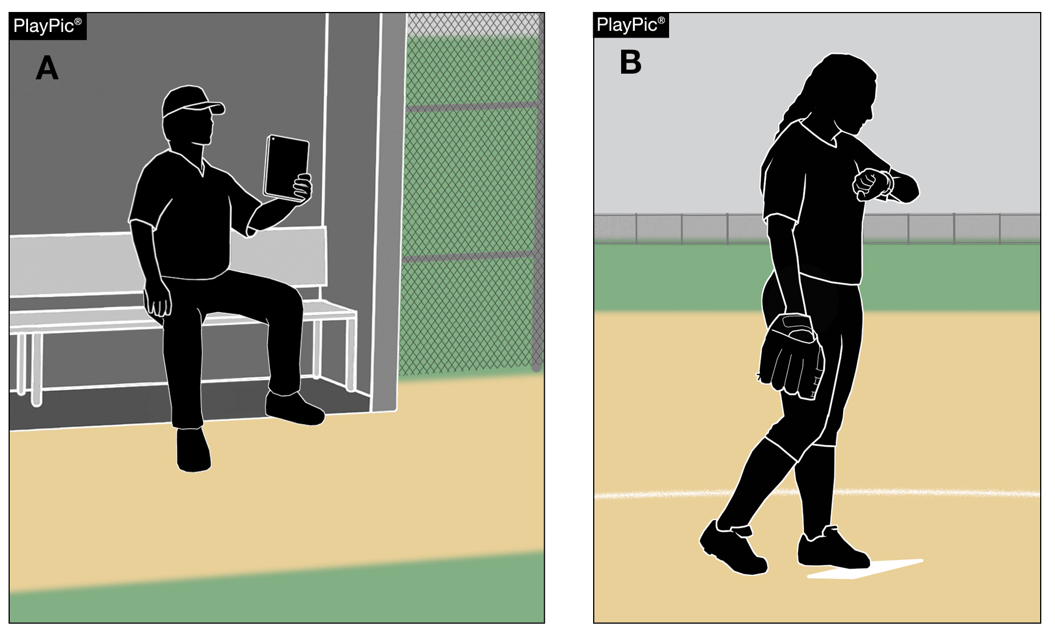
Jewelry and electronic communication
The rule prohibiting jewelry has been removed.
The rule regarding the use of electronics is still in place.
The use of electronic devices by team personnel to transmit or record information pertaining to their players or team’s performance is only permitted within the dugout.
Items such as smart watches are permitted to be utilized as a watch but cannot be used to transmit or receive data outside of the dugout.
Notes:
JEWELRY AND ELECTRONIC COMMUNICATION The rule prohibiting jewelry has been removed allowing team personnel to now wear jewelry; however, the rule regarding the use of electronics is still in place. The use of electronic devices by team personnel to transmit or record information pertaining to their players or team’s performance is only permitted within the dugout. Items such as smart watches are permitted to be utilized as a watch but cannot be used to transmit or receive data outside of the dugout.

Slide 24
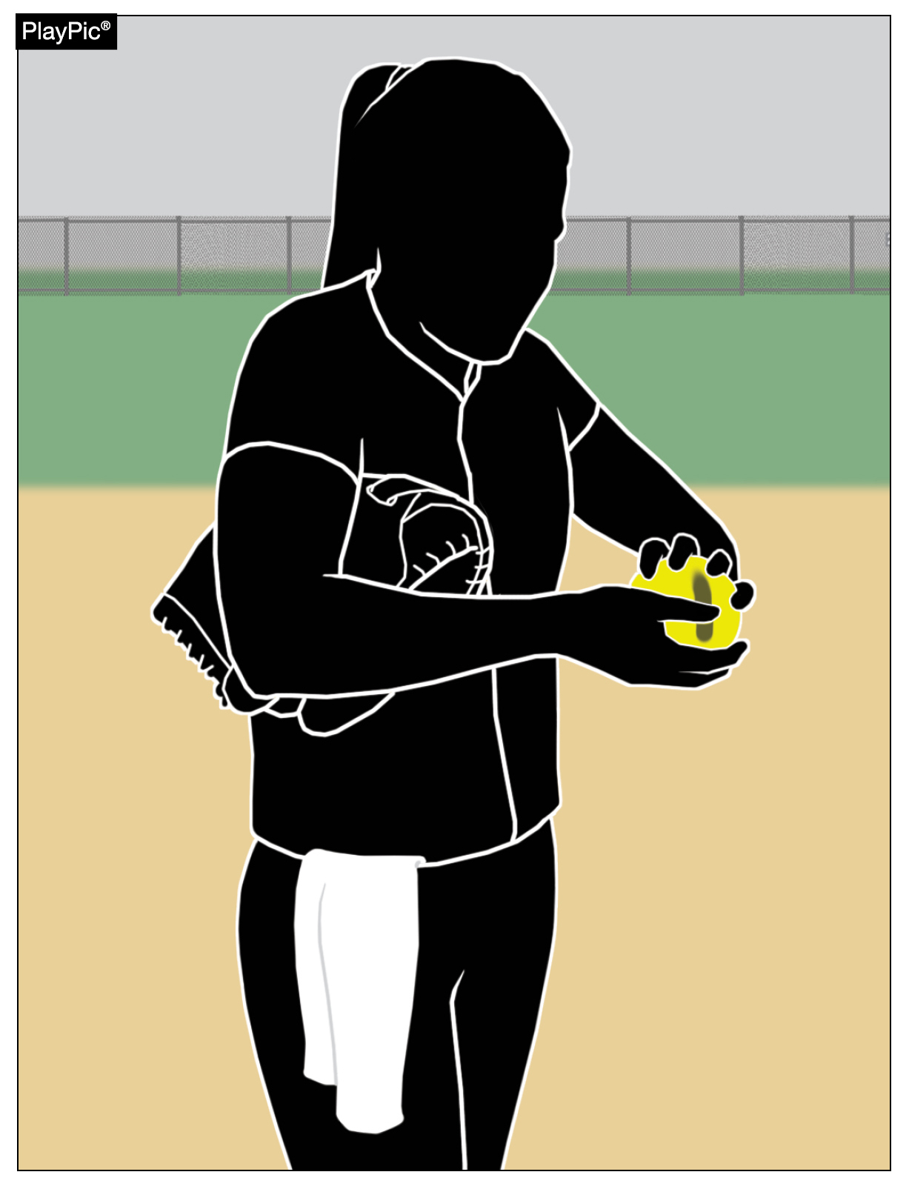
Comparable drying agents
Pitchers are not permitted to use any foreign substance on the ball or on contact points of the pitching hand or fingers.
No foreign substances may be applied to the ball.
If a pitcher licks their fingers, the player must wipe their fingers prior to touching the ball.
Comparable drying agents listed on the USA Softball website (USAsoftball.org) are permitted, and powdered rosin is also permitted.
It is not necessary to wipe off the drying agent before making contact with the ball.
Notes:
COMPARABLE DRYING AGENTS Pitchers are not permitted to use any substance on the ball or on contact points of the pitching hand or fingers; also, no foreign substances may be applied to the ball. If a pitcher licks their fingers, the player must wipe their fingers prior to touching the ball. Comparable drying agents listed on the USA website (USAsoftball.org) are permitted, and powdered rosin is also permitted. It is not necessary to wipe off the drying agent before making contact with the ball.

Slide 25
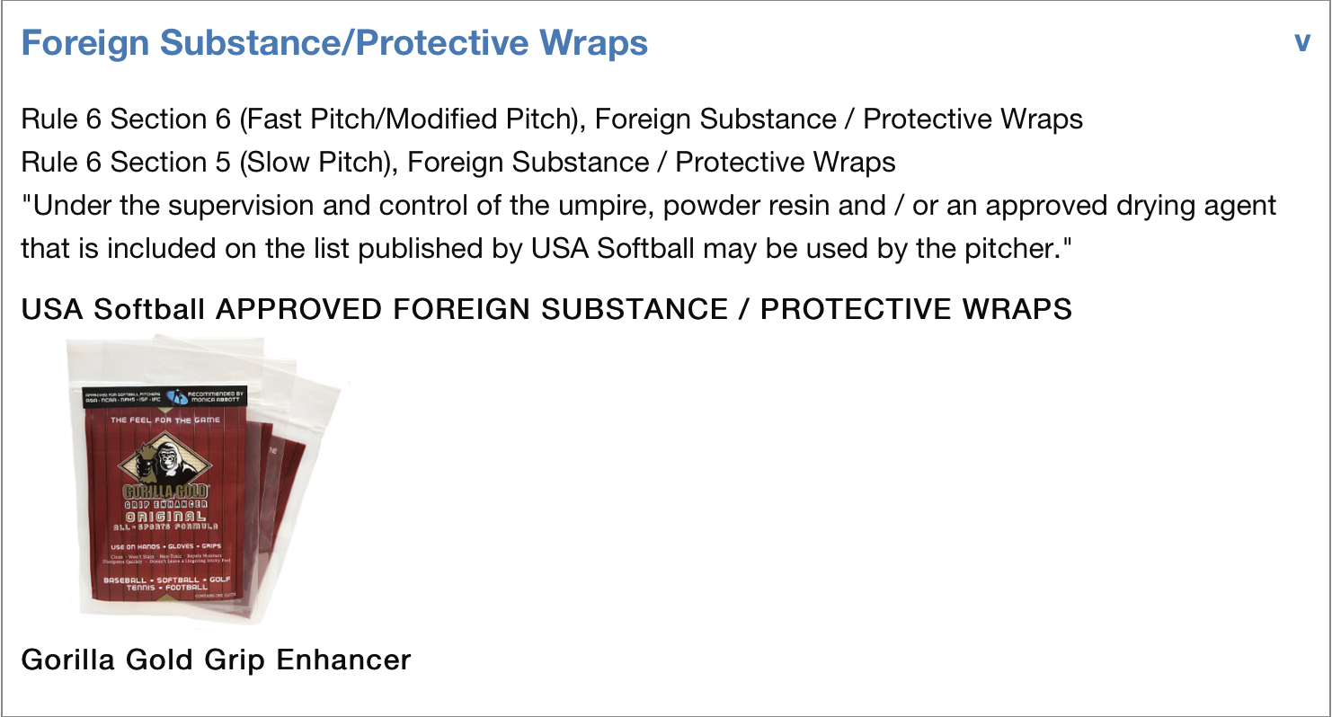
Comparable drying agents
https://www.teamusa.org/USA-Softball/Certified-Equipment
Powder Resin can be on the ground and Gorilla Grip must be kept in the back pocket.
Can be rubbed on your hand but neither can be rubbed on the ball, the same as dirt.
Non-Approved Bat List (2000/2004) https://usa.asasoftball.com/e/BB1P2000.asp
Notes:
COMPARABLE DRYING AGENTS Pitchers are not permitted to use any substance on the ball or on contact points of the pitching hand or fingers; also, no foreign substances may be applied to the ball. If a pitcher licks their fingers, the player must wipe their fingers prior to touching the ball. Comparable drying agents listed on the USA website (USAsoftball.org) are permitted, and powdered rosin is also permitted. It is not necessary to wipe off the drying agent before making contact with the ball.

Slide 26
NFHS OFFICIALS Education

Slide 27
OFFICIALS EDUCATION
Content remains free of charge
TEACHING
AIDS
RULES
CHANGES
DIAGRAMS
VIDEO
LIBRARY
OFFICIALS
COURSES
Notes:
Sport-Specific Officiating courses are offered in several sports. They are ideal for new officials and those in the first few years of officiating. These courses introduce officials to the mechanics and techniques used in the sport and provide specific information on an area within that sport. Individuals can complete a course within 30-45 minutes. These courses are free to all officials and prospective officials.
“Interscholastic Officiating” is a general course on sports officiating, and it is free to all officials and prospective officials. This course provides an introduction to skills and concepts used as an official. Several topics are covered such as: basics of becoming and staying an official, science of officiating, art of officiating, how to combine these skills for successful officiating.
Video clips are made available to NFHS Officials Association members. The video is clipped on specific topics and provides the rules references as well as dialogue on the topic.
The courses and videos are offered at www.NFHSLearn.com .
Courses Available:
Officiating Football
Officiating Volleyball – Ball Handling
Officiating Volleyball – Alignment
Officiating Volleyball – E-Whistle
Officiating Basketball
Officiating Basketball – Three-Person Mechanics
Officiating Basketball – Pre-Game Conference
Soccer – Fouls and Misconduct
Soccer – Offside
Soccer – Pre-Game Conference
Swimming and Diving
Officiating Wrestling
Umpiring Softball
Officiating Field Hockey
Officiating Track and Field
Future Courses to be Considered:
Umpiring Baseball
Umpiring Softball – 2 Person Mechanics
Communication Among Officials and Coaches

Slide 28
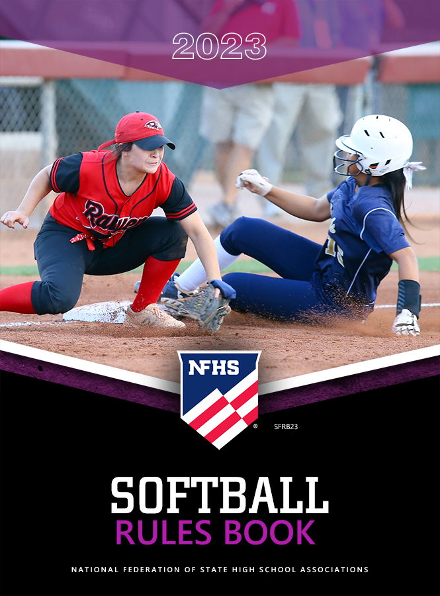
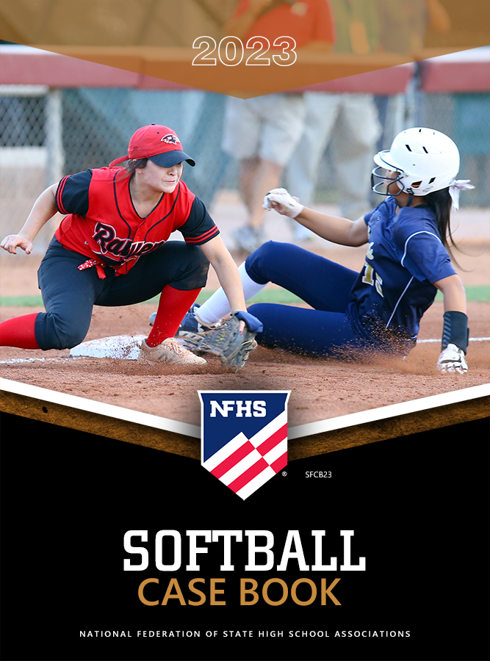
nfhs softball resources
NFHS Rules Books, Case Books and other softball resources can be ordered:
online at www.nfhs.com or
by calling 1-800-776-3462
Notes:
NFHS SOFTBALL PUBLICATIONS
The NFHS softball publications are available to order online or by using the toll-free number.

Slide 29
Thank You
National Federation of State High School Associations PO Box 690 | Indianapolis, IN 46206 www.nfhs.org | www.nfhslearn.com | www.nfhsnetwork.com

