Slide 1
https://goo.gl/Dc2zAM
https://goo.gl/Dc2zAM
Please use your smartphone, computer, or mobile device to complete this short survey.

Slide 2
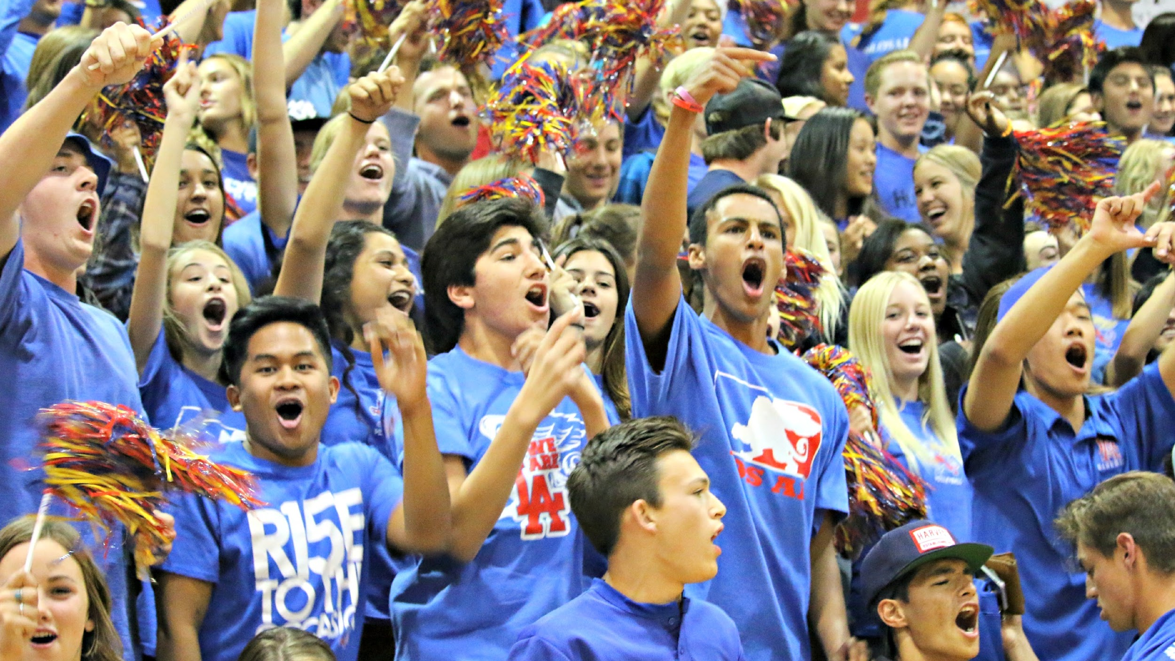
How to Create School Spirit on Your Campus
Brandon Martinez, Issaic Gates, and Keely Hafer
Los Alamitos High School

Slide 3
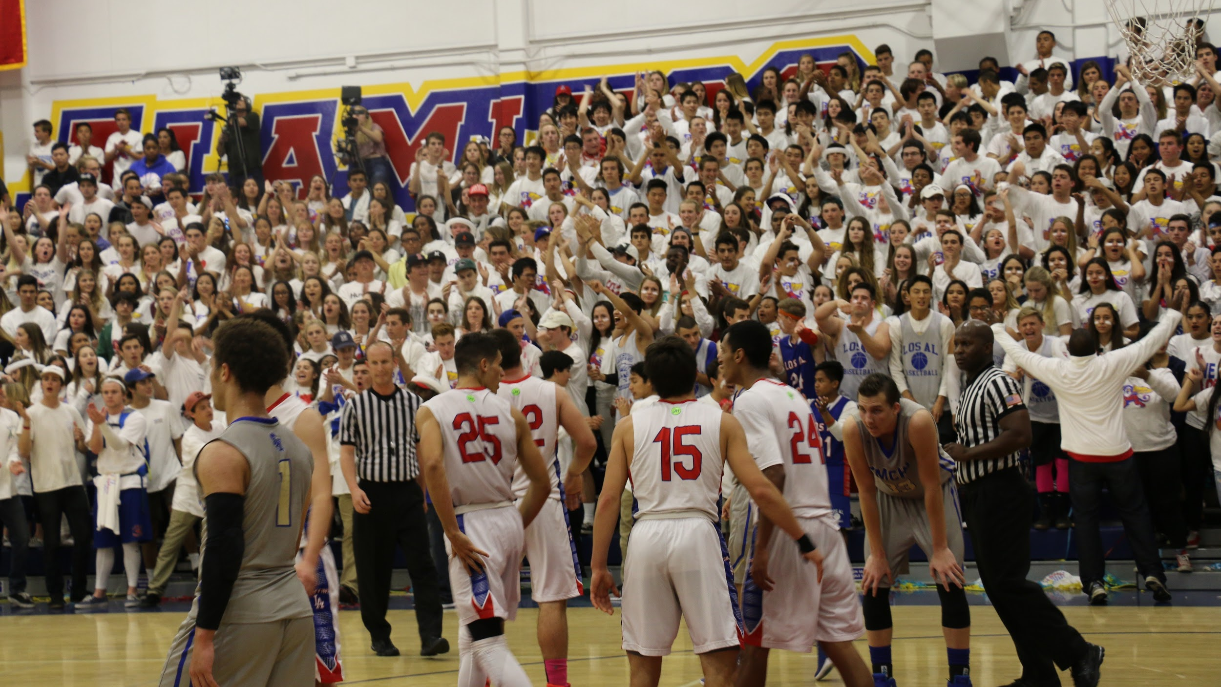
Survey Says...

Slide 4
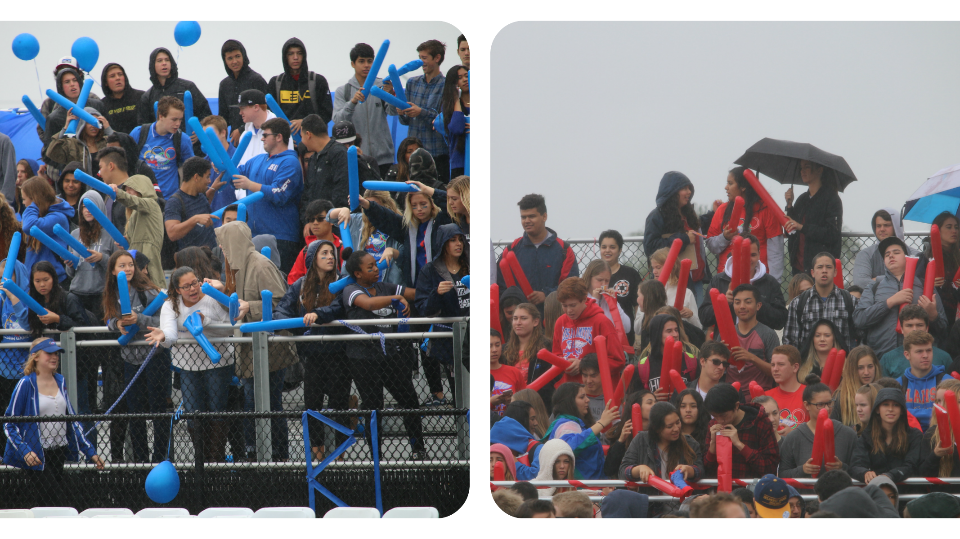
Making Teams

Slide 5
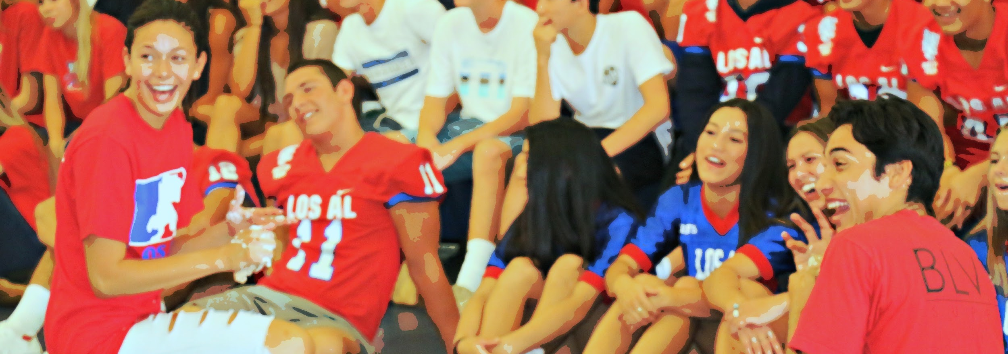
Rank the following in order of most important to school culture and spirit
Habits
Vision
Relationships
Culture/community

Slide 6
HABITS
COMMUNITY
CONNECTIVITY AND VISION
SCHOOL SPIRIT!
TRUST
RELATIONSHIPS

Slide 7
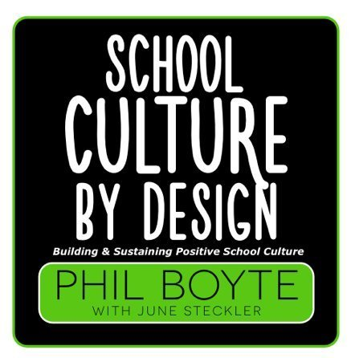
Notes:
Strategies for establishing the foundations of school culture
Learn strategies for communicating with stakeholders.
Learn strategies for increasing student attendance and participation at athletic events.
Learn strategies for elevating all sports.

Slide 8
The first thing you have to decide is IF your school culture is in a state of EMERGENCY!
Notes:
Urgency priority need want

Slide 9
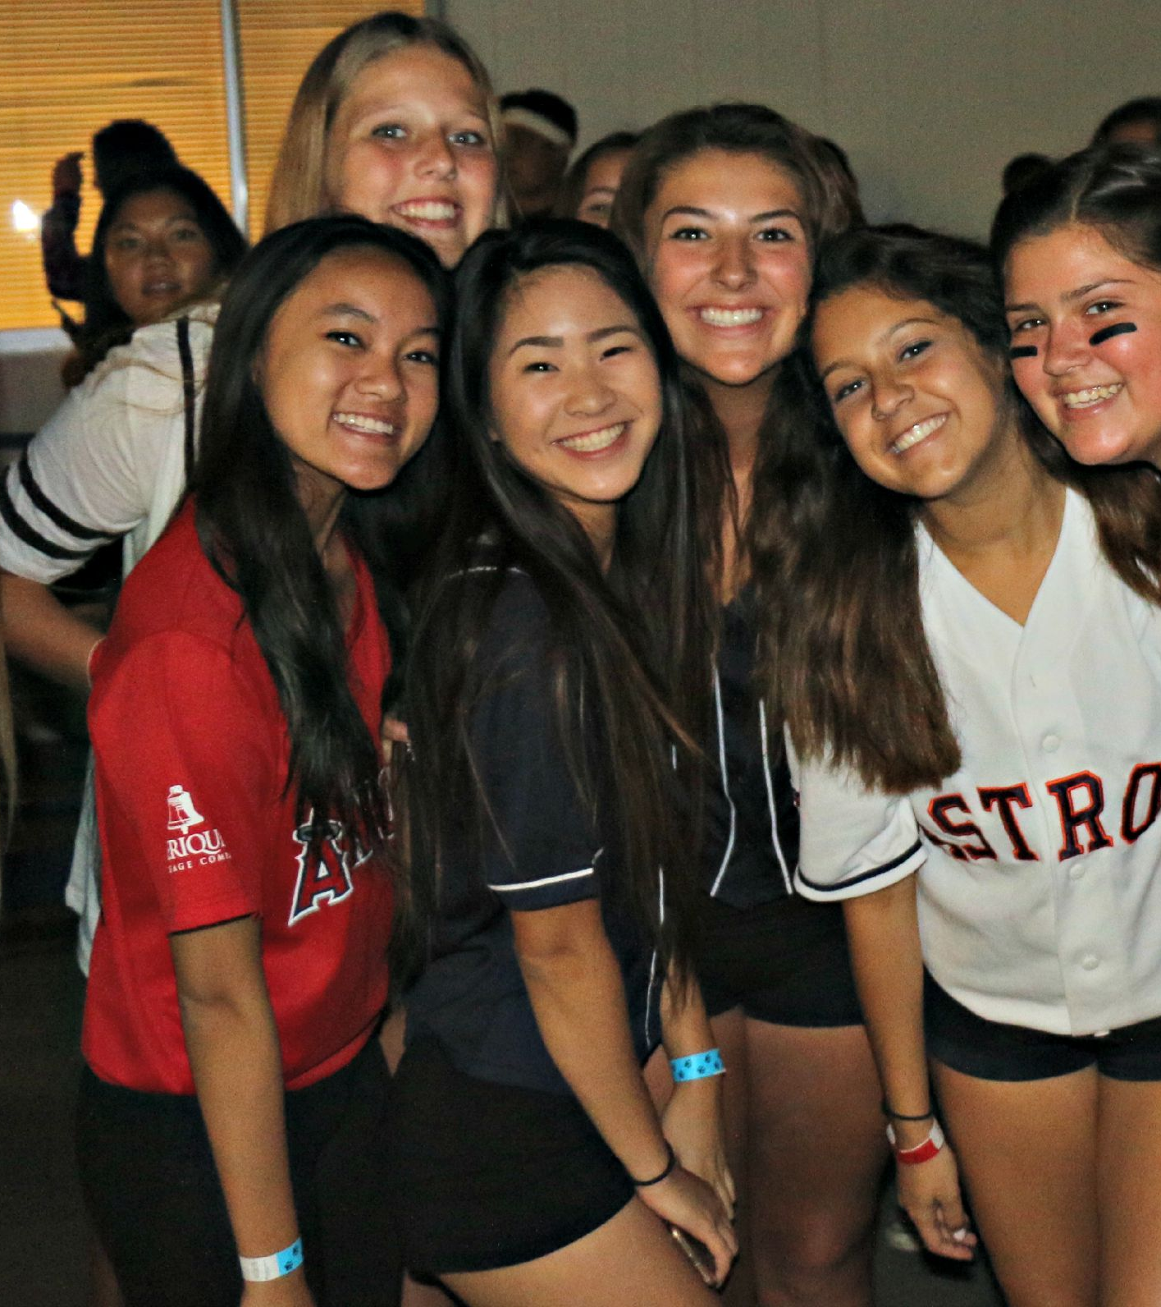
Relationships:
Shared Common Experience
Communication
Pictures & Videos
Opportunities for staff team building
Conversations with students
Social Media
Notes:
Relationships are everything, opportunities to create relationships are everything else
Opportunities for people to listen to each other
Marshmellow challenge pictures, drones
Follow us pic

Slide 10
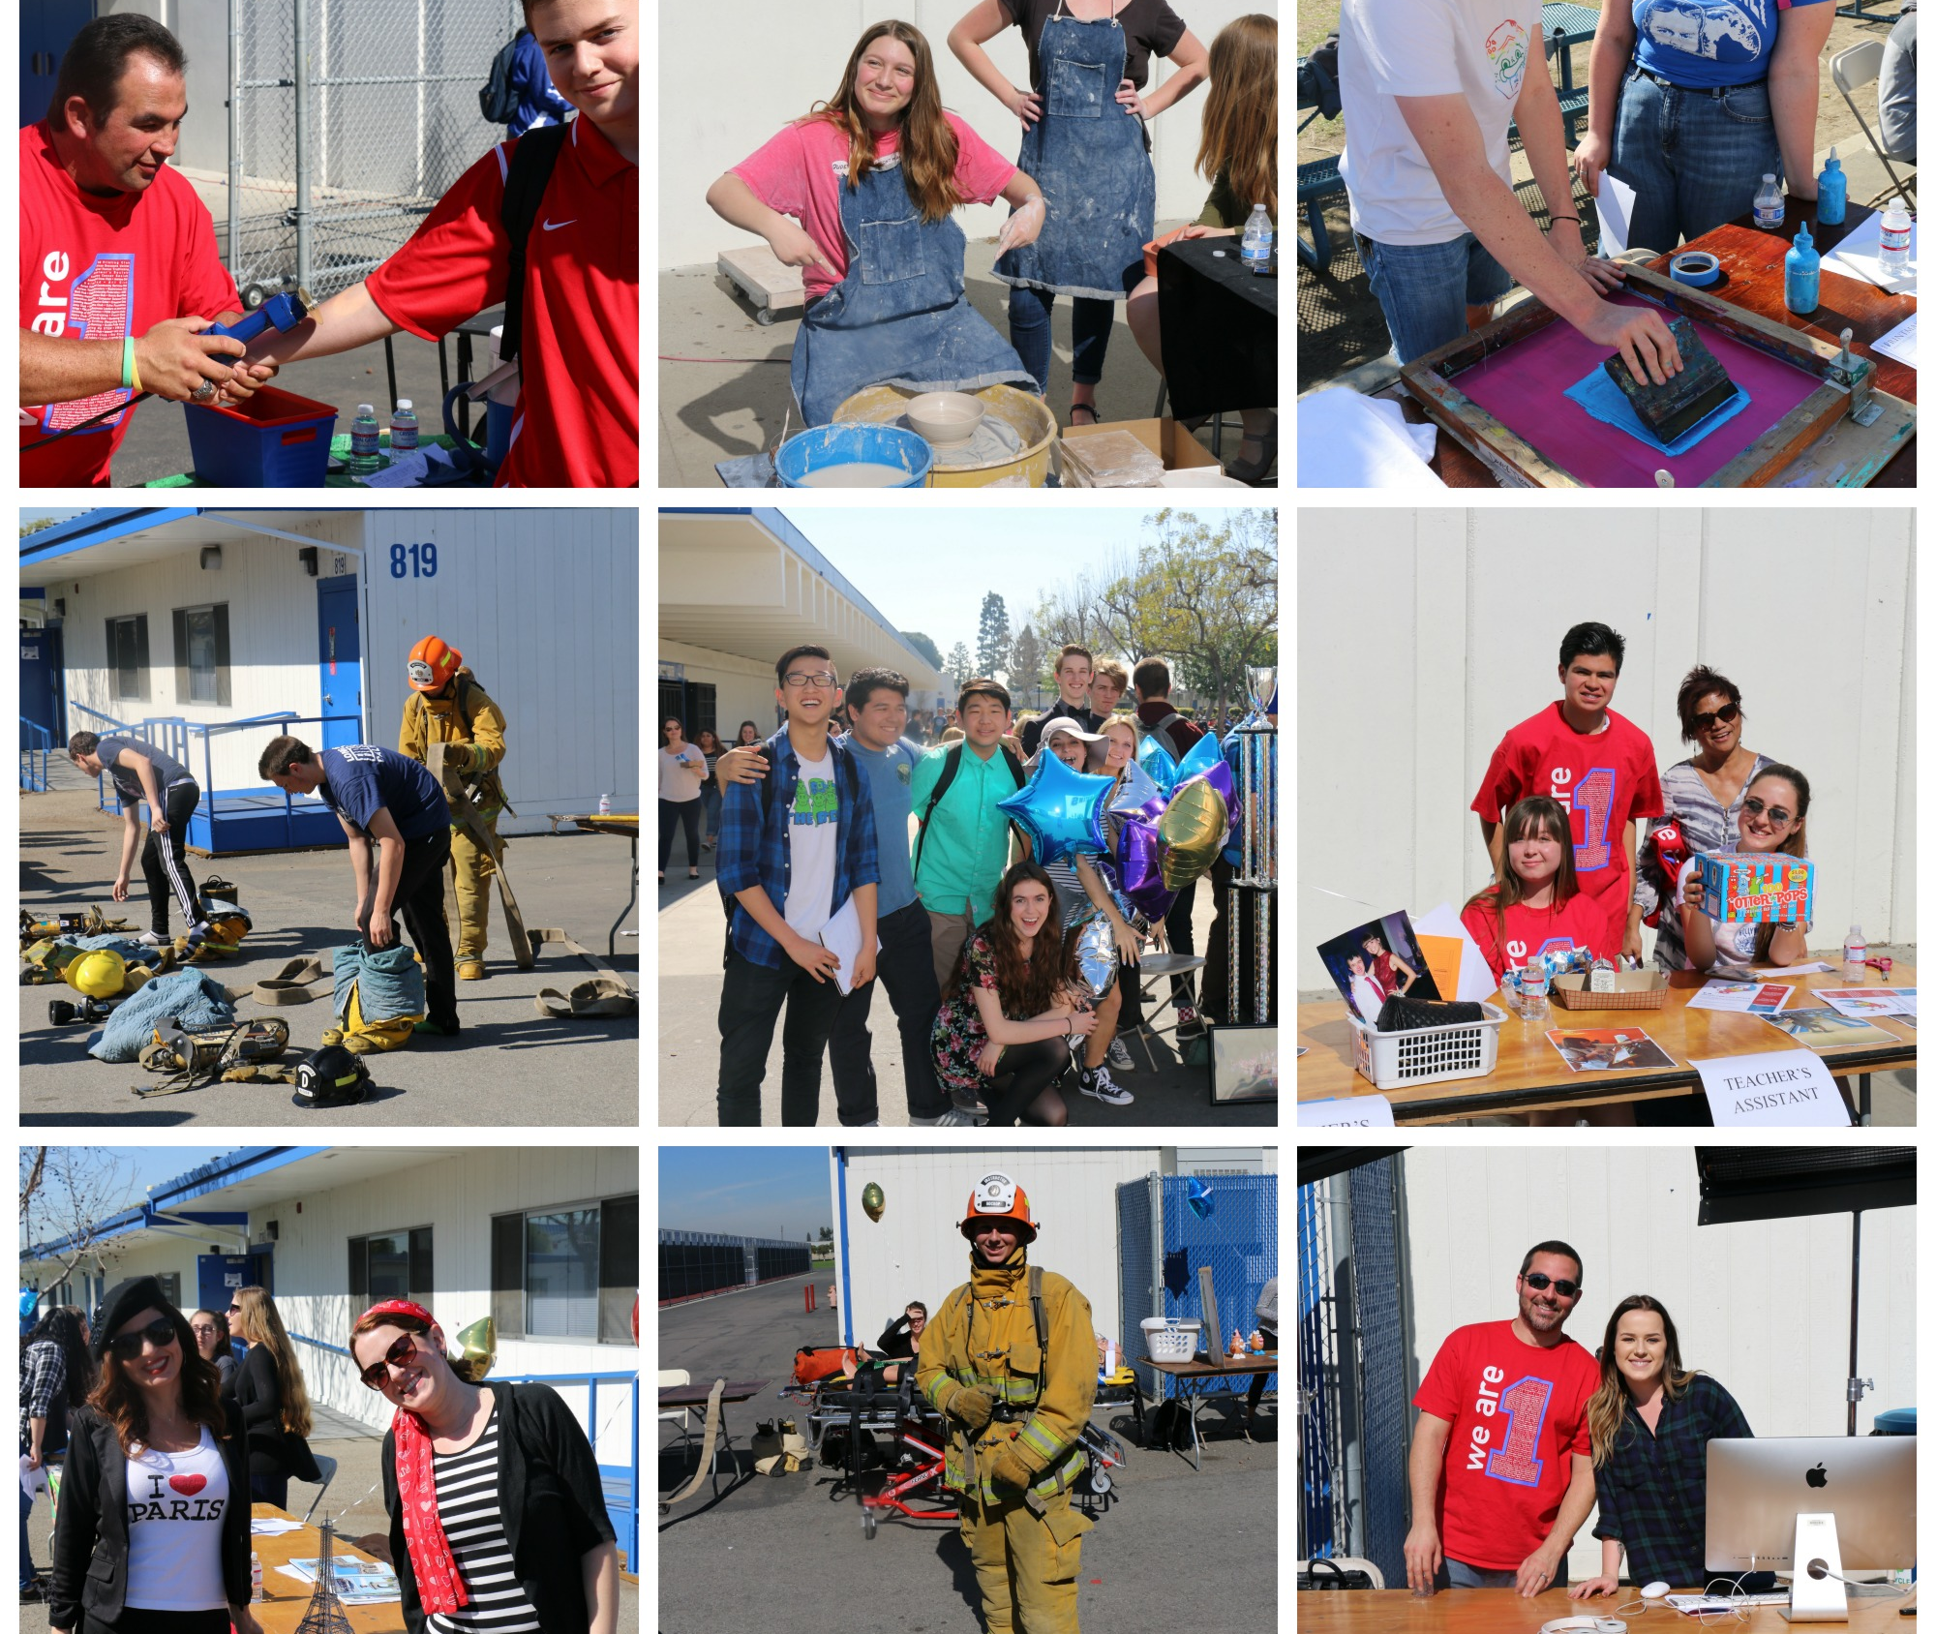
Relationships Level 2 (Trust)
C2K
Celebrate others
Flat Griffin
Be everywhere all the time!
Notes:
Boyte calls it trust

Slide 11
Activities support culture, culture supports EVERYTHING!

Slide 12
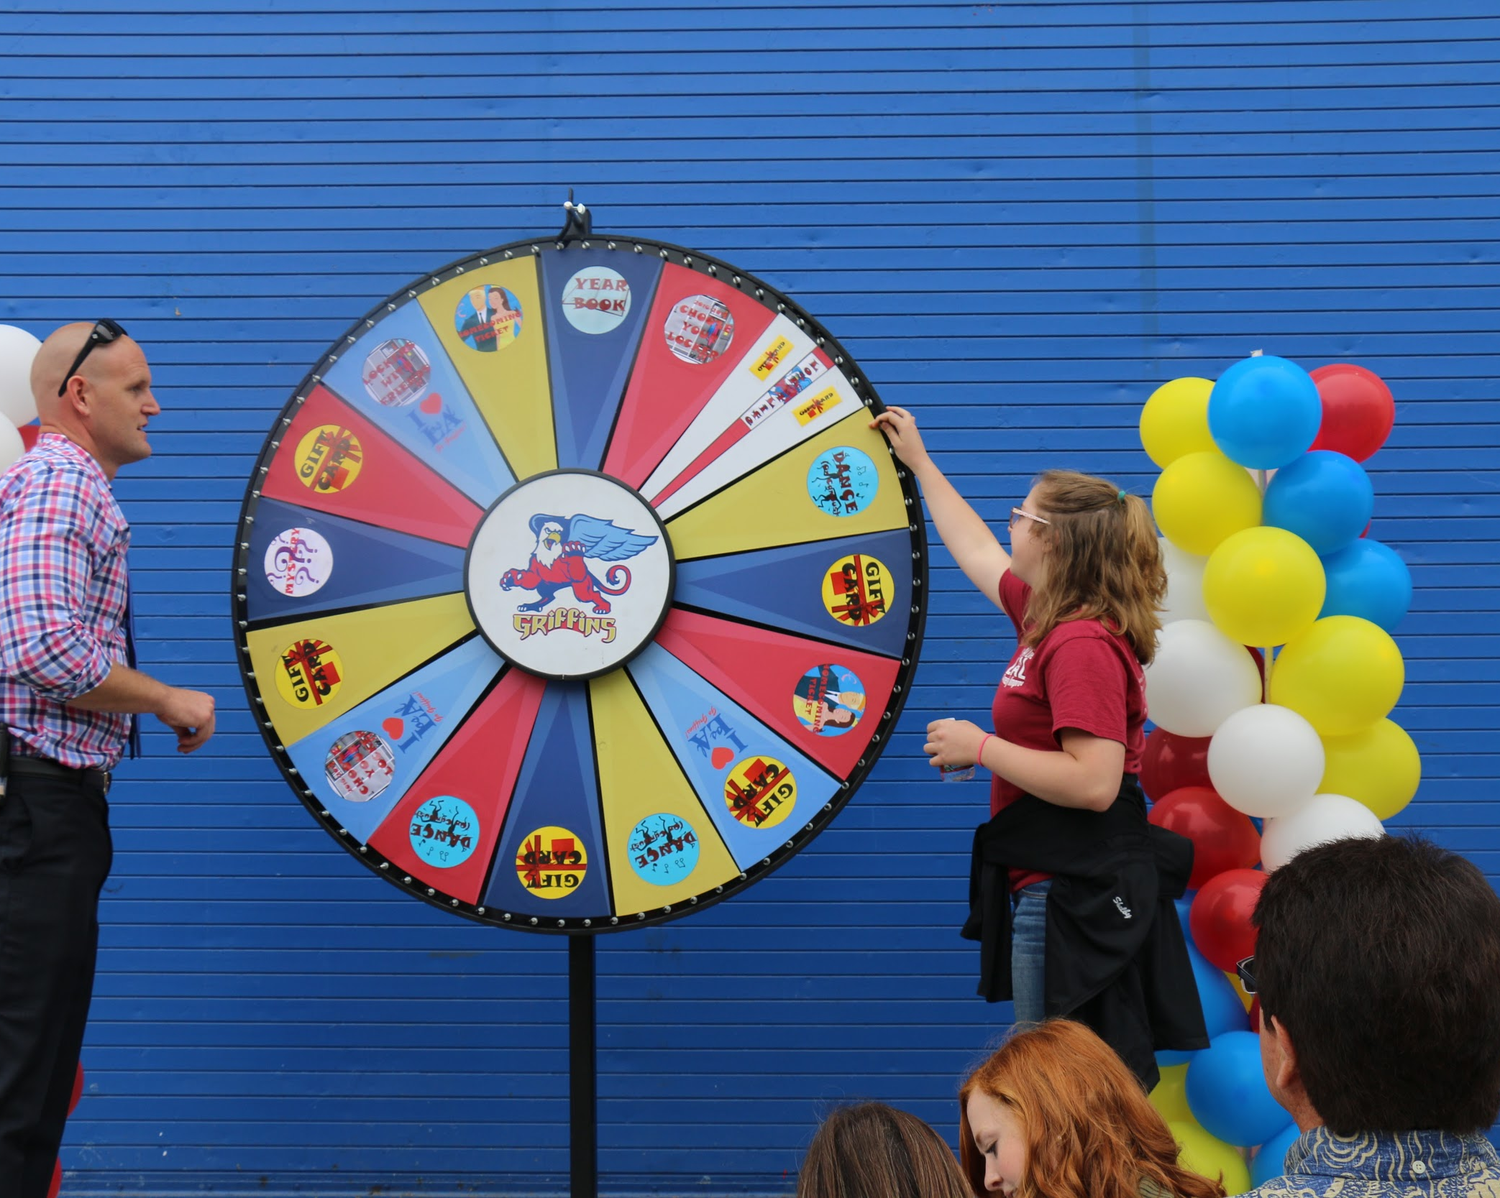
Connectivity and Vision
PBIS
SWAG
Los Al 4 Life
Connectivity
Hashtag wars Pics Art App
Spirit Packs
Food giveaways
Griffin Games
Boosters
Notes:
Consistently get students and community warmed up for larger events through other events such as lunch on the lawn, flat griffin. All these relationships support the experiences. Lunch on the lawn vs. lunch at the game. We do activities to be able to do larger activities

Slide 13
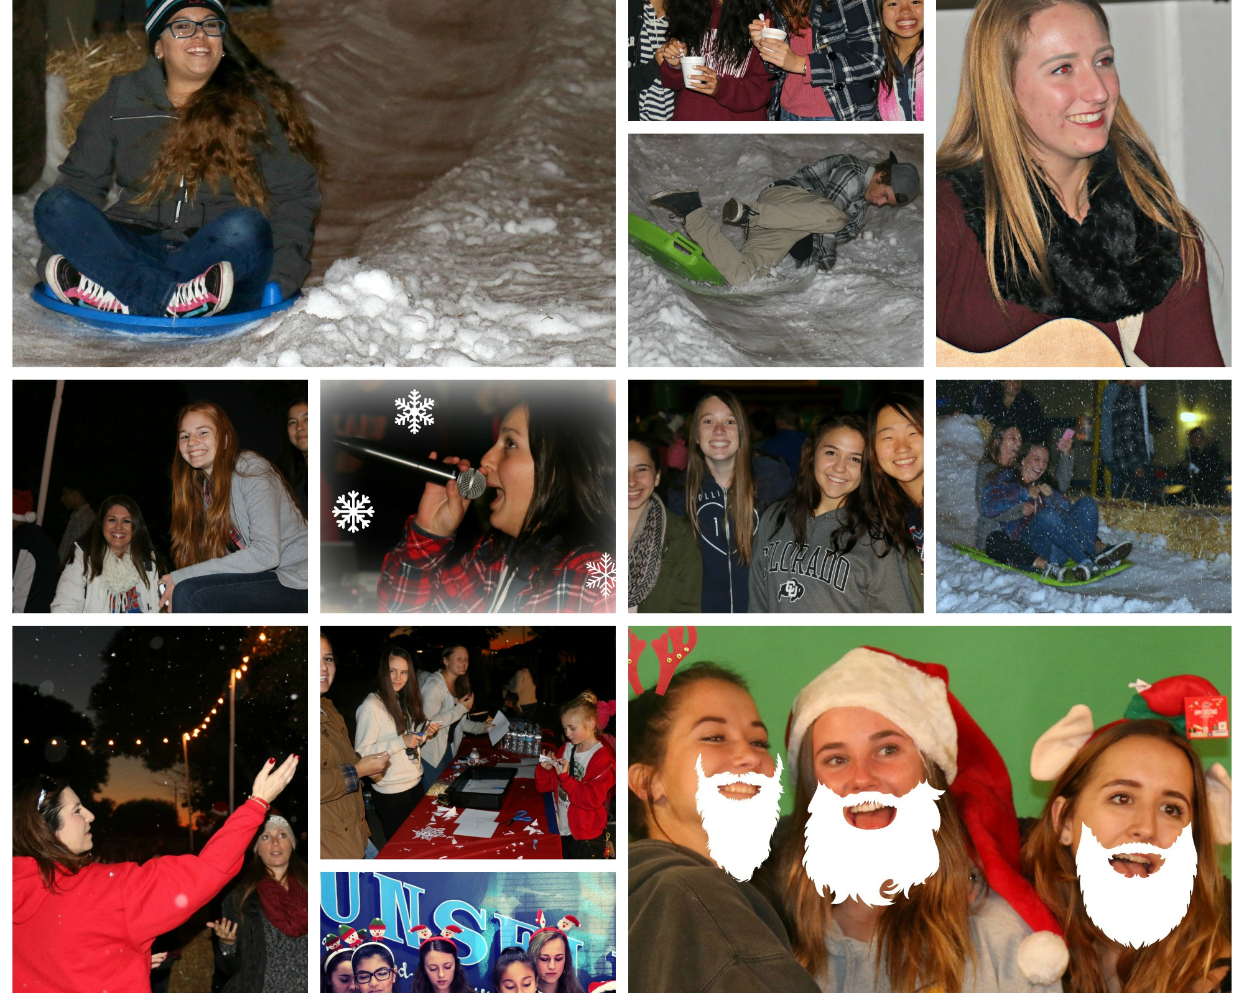
The Culture of Community
ALS Ice Bucket Challenge/Cupcakes for Cancer
Harlem Shake
Use of PTSA for Hot Dogs
Staff “Lunch on the Lawn”/Pep rally
Winter Wonderland
Notes:
Now that we have relationships and shared common experiences, we are connected and can come together as a community. When you build relationships the expectations change on campus. People want to further the relatioships they have. They want to be a part of the events and the community. There is a foundation that allows us to participate in common experiences. The culture is created where we attend school activities. People come because we have relationships.

Slide 14
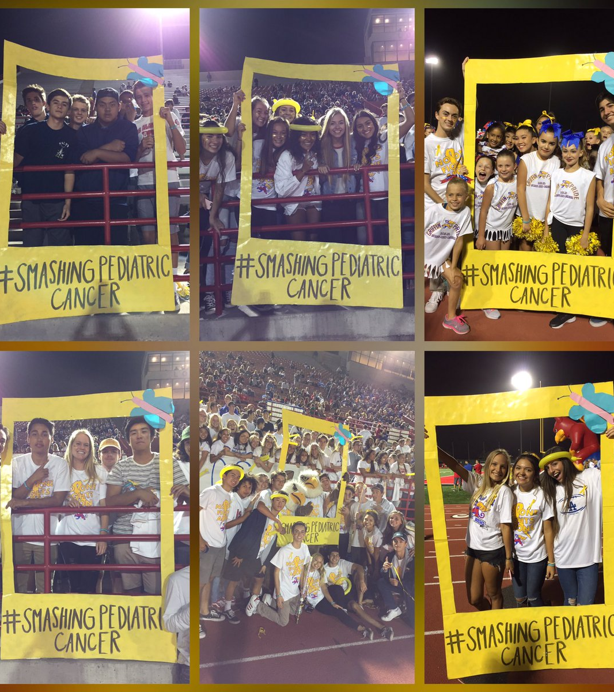
Details, AKA Habits
Branding is key
Bring awareness of your school to your school
Make staff famous
Make the community aware
Monday Morning Memo
Notes:
branding= windscreen
Make staff famous= door signs
Community- social media, newsletter, hype after events

Slide 15
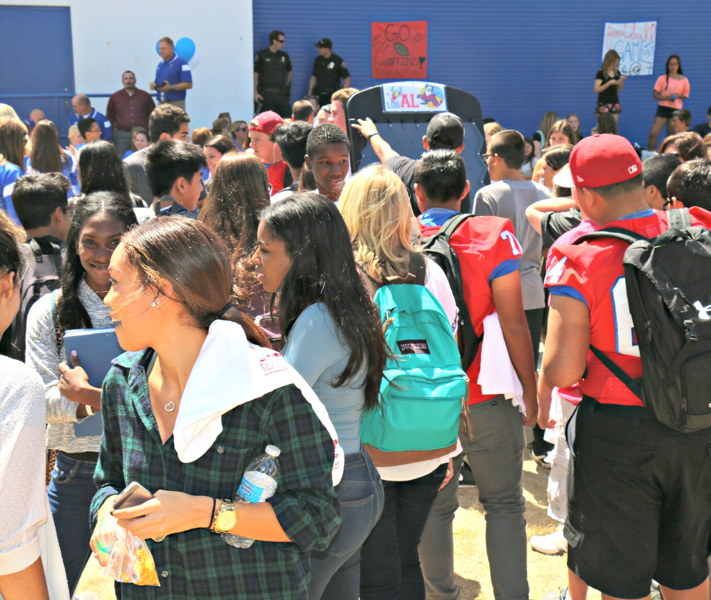
Sustainable culture
Who does this work?
Who values this work as urgent?
Who see it as an emergency?
GET EVERYONE ON BOARD!

Slide 16
Costs: How do you pay for it?
Strategies for paying for it
Branding, using more than once, that occasions
Getting the reluctant teachers involved--want to feel involved.
“High risk behavior” high rates of participation low barriers to participation
Not alone!

Slide 17
Be patient. Keep building!

Slide 18
Questions???
Post-survey
https://goo.gl/Bb1p9

