Slide 1
LCAP Funding for Athletics 2.0
Candace Cayer, Assistant Principal
La Puente High School
Hacienda-La Puente Unified School District

Slide 2
Student Achievement
Connection between student achievement & athletics
Test Scores
Grades
Student
Achievement
Extra-
Curricular
Activities

Slide 3
Student Achievement & Athletics
Common Core
Content Standards
Grades
CAHSEE Testing
SBAC Testing
Physical Fitness Testing

Slide 4
So….
Lets Review

Slide 5
LCAP Funding
What State Standards must the LCAP address as part of Priority 2? (Posted 21-Oct-2014)
The LCAP must include goals and related actions that address implementation of the academic content and performance standards adopted by the State Board. The content standards adopted by the California State Board of Education are listed on the next slide

Slide 6
10 State Content Standards
English Language Arts – Common Core State Standards for English Language Arts, Adopted August 2010
Mathematics – Common Core State Standards for Mathematics, Adopted August 2010 and modified January 2013
English Language Development, Adopted November 2012
Career Technical Education, Updated January 2013
Health Education Content Standards, Adopted March 2008
History-Social Science, Adopted October 1998 Model School Library Standards, Adopted September 2010
Physical Education Model Content Standards, Adopted January 2005
Next Generation Science Standards, Adopted 2013
Visual and Performing Arts, Adopted January 2001
World Language, Adopted January 2009

Slide 7
Physical Education Model Content Standards
STANDARD 1
Students demonstrate knowledge of and competency in motor skills, movement patterns, and strategies essential to perform a variety of physical activities.
STANDARD 2
Students achieve a level of physical fitness for health and performance while demonstrating knowledge of fitness concepts, principles, and strategies.
STANDARD 3
Students demonstrate knowledge of psychological and sociological concepts, principles, and strategies that apply to the learning and performance of physical activity.

Slide 8
Physical Education Courses
High School Course 1
High School Course 2
Adventure/Outdoor Activities*
Aerobics*
Individual Dual Sports*
Dance*
Aquatics
Weight Training & Fitness
* Advanced Courses offered as well

Slide 9
PE Course – Athletics Alignment
Football
Basketball
Volleyball
Baseball
Softball
Soccer
Wrestling
High School Course 1
High School Course 2
Adventure/Outdoor Activities*
Aerobics*
Individual Dual Sports*
Dance
Aquatics
Weight Training & Fitness
Cheer
Golf
Badminton
Tennis
Swimming
Diving
Water Polo
All

Slide 10
Components for LCAP
Tie to the Common Core
Writing Component

Slide 11
PE Content Sub-standards
1.3 Explain the skill-related components of balance, reaction time, agility, coordination, explosive power, and speed that enhance performance levels in combative, gymnastic/tumbling, and team activities and apply those components in performance.
1.4 Explain and demonstrate advanced offensive, defensive, and transition strategies and tactics in combative, gymnastic/tumbling, and team activities.

Slide 12
Sample Assignments
Game film review
Tie to substandard 1.4 – offensive and defensive strategies
Have athletes write why they executed what they did and what are some possible strategies to improve the execution of the skill

Slide 13
Fitness/agility – workout plan
Standard 1.8
Analyze and explain which training and conditioning practices have the greatest impact on skill acquisition and performance in combative, gymnastic/tumbling, and team activities.
Standard 2.6
Develop and describe a physical fitness plan that enhances personal health and performance in future leisure and workplace activities.

Slide 14
Now….
Here’s Some New Information…

Slide 15
Student Plan for Academic Achievement (SPSA)
Academic Goals
Non-academic Goals
Budget
School Site Council/Shared Decision Making Approval

Slide 16
Student Plan for Academic Achievement (SPSA)
English Language Arts
Mathematics
English Learners
School Climate

Slide 17
Student Plan for Academic Achievement (SPSA)
English Language Arts
Action Step | WASC Critical Needs | Responsibility | Timeline | Cost/ Funding | LCAP Priorities
Athletic courses will embed Common Core | Academic Vocabulary Analytical Thinking | Administration | Ongoing | $2,000 LCFF S&C | Common Core Student Achievement
ELA standards during lessons supporting |  | Teachers
literacy across all content areas |  | Coaches

Slide 18
Student Plan for Academic Achievement (SPSA)
Mathematics
Action Step | WASC Critical Needs | Responsibility | Timeline | Cost/ Funding | LCAP Priorities
Athletic courses will utilize 8 Math practices to determine the intensity of workouts | Math Practices Analytical Thinking | Administration | Ongoing | $2,000 LCFF S&C | Common Core Student Achievement
 |  | Teachers
 |  | Coaches

Slide 19
Student Plan for Academic Achievement (SPSA)
English Learners
Action Step | WASC Critical Needs | Responsibility | Timeline | Cost/ Funding | LCAP Priorities
Athletic lessons will incorporate visuals, kinesthetic practice and academic vocabulary to teach physical education content standards | Academic Vocabulary Analytical Thinking | Administration Teachers Coaches | Ongoing | $5,000 LCFF S&C | Student Achievement

Slide 20
Student Plan for Academic Achievement (SPSA)
School Climate
Action Step | WASC Critical Needs | Responsibility | Timeline | Cost/ Funding | LCAP Priorities
The athletic department will create a positive school climate working with the associate student body during games with pre-game, halftime and post game activities | School Climate | Administration Teachers Coaches | Ongoing | $10,000 LCFF S&C | Student Engagement

Slide 21
Action Step | WASC Critical Needs | Responsibility | Timeline | Cost/ Funding | LCAP Priorities
Physical Education & Dance supporting the common core through the California Physical Education standards - vocabulary, analytical thinking, through writing and projects (material, supplies, equipment) and to meet Federal Program Monitoring (FPM) | Math Practices Analytical Thinking Academic & Behavior Interventions School Climate | Administration Dance Teacher PE Department | Ongoing | $5,000 LCFF S&C | Student Achievement Student Engagement
Athletics - Ongoing repair and replacement of athletic equipment, safety items, athletic trainer supplies, uniforms and equipment required by NFHS & CIF for participation and to support the classes in the master schedule | School Climate | Administration Athletic Director | Ongoing | $20,000 LCFF S&C | Student Achievement Student Engagement

Slide 22
Action Step | WASC Critical Needs | Responsibility | Timeline | Cost/ Funding | LCAP Priorities
Athletics – student academic support through team study halls and tutoring | Academic & Behavior Interventions School Climate | Administration Athletic Director Coaches | Ongoing | $2,000 LCFF S&C | Student Achievement Student Engagement

Slide 23
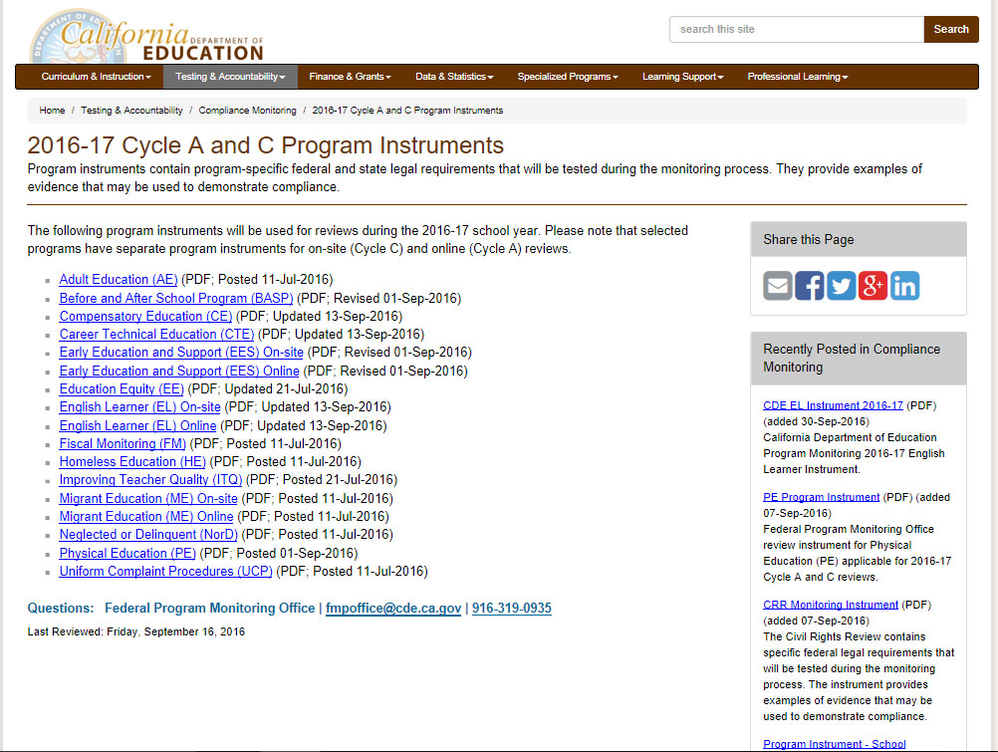
Federal Program Monitoring (FPM) 17 Components
Physical
Education

Slide 24
Lesson Planning – Common Core
English Language Arts
Mathematics
Science
***Tie to Physical Education Standards

Slide 25
Lesson Planning – Common Core
Lesson Topic | Common Core Standard | Physical Education Standard
Game Film Breakdown | English Language Arts | Standard #1
Offense & Defensive Sets | Standard #4 Writing
Adversity | English Language Arts | Standard #3
Response to Literature | Standard #9 Writing
Target Heart Rate | Mathematics | Standard #2
 | Algebra - Reasoning with
 | Equations
Speed vs. Muscle Mass | Nest Generation Science | Standard #1
 | HS-PS2-1

Slide 26
Lesson Planning – QR Code Generator
Lesson Plan Links

Slide 27
Benefits of LCAP
Use of categorical funds on athletics
Enhances the focus on Common Core
Allows on-campus coaches to have 6th period PE classes – hour of contact does not count toward the 18 hour rule
Practice times can be adjusted to allow students to have more time for homework
Helps maintain a focus on student achievement

Slide 28
Questions?

Slide 29
Contact Information
Candace Cayer
Email: ccayer@hlpusd.k12.ca.us
Phone: (626) 934-6702
Cell: (213)369-2337

